Slide 1
Methods, technology and system for automatic prediction of earthquakes¹⁾
V. G. Gitis, A. B. Derendyaev
Institute for Information Transmission Problems RAS (Kharkevich Institute)
gitis@iitp.ru, wintsa@gmail.com
___________________________
¹⁾ The work was supported by the Russian Science Foundation, project 14-50-00150, and Russian Foundation for Basic Research, projects 17-07-00494 and 16-07-00326.

Slide 2
Preface
Possible sources of data:
Instrumental online observations.
Historical seismicity.
Properties of the geological environment.
Data types:
Marked point fields (catalogs of earthquakes).
Time series.
Earth Remote Sensing raster data.
Digital geological and geophysical maps.
Factors for a successful forecast:
Completeness of the forecast objects description.
Joint processing of all object's properties.
For joint processing, the system converts all types of data into grid fields.

Slide 3
Mode of operation
The system operates regularly with the step Δt = const.
At the moment t the system performs the following actions:
Loads new input data about the seismic process.
Converts input data to grid fields.
Calculates spatial and spatio-temporal feature fields.
Calculates the alarm zone for a time T ≥ Δt. The alarm zone a function of a set of feature fields.
Combines all the alarm zones calculated in the previous steps.
Forecast
The earthquake is predicted if the total alarm area covers its epicenter.

Slide 4
CONTENT
Method of minimum area of alarm.
Technology.
Platform.
Testing.

Slide 5
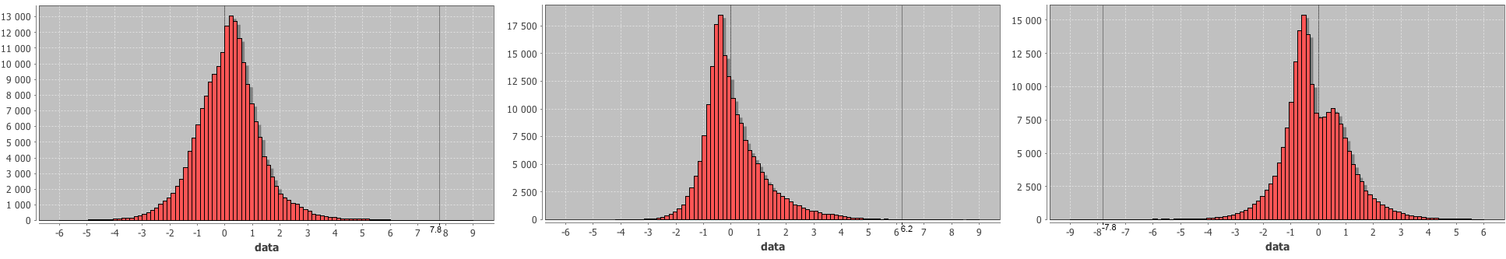
Method of minimum area of alarm
1.1. Model of data
1. Predictable events are preceded by anomalous and unlikely values of feature fields.
2. The feature fields are constructed in such a way that the anomalies refer either to their largest or smallest values. For the sake of simplicity, we will further assume that the probability distributions of the feature fields and the forecast field are such that the anomalies are refer only to their largest values.

Slide 6
Модель
Monotonicity condition:
If a vector f^{(q)}={f_{i}^{(q)}} from the feature space, i=1,2,…, I precedes an event q (i.e. f^{(q)} is a precursor of the event q), then any vector f^{(n)}={f_{i}^{(n)}} with components f_{i}^{(n)} ≥ f_{i}^{(q)} for all i=1 ,…, I also can be a precursor of a similar event.
Base
points
Values of feature field i
f_{i}
Space of features
f
•
•
•
•
•
•
•
•
•
•
•
f^{(q)}
f_{j}
Values of feature field j

Slide 7
1.2. Definitions
Alarm rule
If in a grid node n the value of the forecast field φ^{(n)}> θ,
then alarm is announced in a cylinder of alarm with the
center of the base at the node n, radius R, and the element T.
Time
Cylinder of alarm
R
t+T
Earthquake epicenter
T
Δt
Space
t
Grid node n with φ(x^{(n)}, y^{(n)}, t^{(n)}) ≥ θ

Slide 8
Forecast rule
Combination of alarm cylinders forms the area of alarm.
The earthquake is successfully predicted if its epicenter is located inside the area of alarm.
Forecast quality
Probability of earthquake detection:
a number of detected events
U(θ)= –––––––––––––––––––––––––––––––––––––––––––
a number of all predictable events
The total volume of alarm=Probability of earthquake detection by a random field:
a number of grid nodes in the total area of alarm
V(θ)= ––––––––––––––––––––––––––––––––––––––––––––––––
a number of grid nodes in all area under study

Slide 9
The ratio U*/ U₀ shows in how many times systematic forecast is better than random forecast.
The dependence of the earthquake detection probability on volume of alarm U(V)
(Receiver Operating Characteristic)
U(θ)
1
U* - earthquake detection probability for the predictive field.
U*
U(V)
- Systematic prediction
U₀=V* - earthquake detection probability
for a random field.
U(V)=V
- Random
prediction
U*/U₀ – quality of
systematic prediction
with respect to random
one.
U₀
V(θ)
V*
1
Notes:
Цель – представить результаты ЭЗ

Slide 10
Cylinder of precursor
The earthquake q with the epicenter’s coordinates (x, y, t) will be forecasted if and only if the cylinder of precursor with the center of base at (x, y, t), radius R and the element (T-Δt) contains at least one grid node with the predictive field value φ≥θ.
Time
Earthquake epicenter
q
(x,y,t)
t
R
Space
Cylinder of precursor
T-Δt
Δt
Step of grid

Slide 11
1.3. Machine learning algorithm
For training we have several feature fields and a set of occurred earthquakes.
t
Criterion:
We would like to create an alarm field that predicts the maximum number of epicenters with the volume of the alarm area (in space and time) no more than indicated.
X
Y

Slide 12
Step 1. Generate a training sample {f^{(q)}, v^{(q)}}, which
consists of earthquake precursors f^{(q)} and
the corresponding volumes of alarm v^{(q)}.
t
q
The precursor of the event q is a vector in the feature space f^{(q)} =( f_{i}^{(q)}), which corresponds to the grid node of the precursor’s cylinder with the minimum alarm volume v^{(q)}.
Cylinder
of precursor
X
Y

Slide 13
Now for training we have:
A sample of earthquake precursors and corresponding to them alarm volumes.
All other vectors of feature space, a small portion of which may be the precursors of similar events.
The problem is to extract the maximum number of earthquake precursors, so that the number of other vectors of feature space was no more than predetermined.
This machine learning task is known as One class classification problem.

Slide 14
Step 2. Order the precursors
(for example, so that v^{(Q)}≤v^{(Q-1)}≤ …v⁽²⁾≤v⁽¹⁾)
t
f_{i}
•
•
•
•
•
•
Base
points
Q
•
•
•
f^{(Q)}
•
•
•
f^{(Q-1)}
Q-2
•
Q-1
f^{(Q-2)}
X
f_{j}
Following the monotonicity condition, the base points can be precursors of similar events
Y

Slide 15
Step 3. Construct a forecast field in which events are
detected in a predetermined sequence Q, Q-1, …, 1.
3.1. Assign the value "0" to all grid nodes of the forecast field.
3.2. Replace the value “0” on “Q" in the base nodes corresponding to the precursor f^{(Q)}.
3.3. Replace the value “0” on “Q-1” in the base nodes corresponding to the precursor Q-1.
…..
Further to the precursor 1.
Q
•
f_{i}
•
•
•
•
•
•
•
•
f^{(Q)}
•
•
Q-1
•
f^{(Q-1)}
Q-2
•
f^{(Q-2)}
f_{j}

Slide 16
Properties of the forecast field
As the threshold θ is reduced, the forecast field sequentially detects events Q, Q-1, Q-2 ..., 1.
Versions of algorithm allow:
Optimize the forecast field so that when any next event is detected, the alarm volume increases by the minimum value.
Optimize the forecast field so that it detects the maximum number of events with an alarm volume of not more than the specified value.
U(θ)
1
U(Q)=1/Q
V(θ)
0
V(Q)=v^{(Q)}
1

Slide 17
2. Technology
The technology combines two levels of data analysis:
The first level supports automatic data analysis with an intuitive understandable interface and visual presentation of the results, available to a wide class of users.
The second level is designed for detailed analysis of hypotheses, which an expert could formulate at the first level.

Slide 18
The technology has been tested on two our web-platforms:
1. The platform for monitoring of seismic activity fields
(in cooperation with Kamchatka Branch of Geophysical Survey, RAS)
IITP RAS:
http://distcomp.ru/geo/2/,
http://distcomp.ru/geo/3/.
Kamchatka Branch of GS, RAS: http://saltlab.emsd.ru/server2/,
http://saltlab.emsd.ru/server3/.
2. The paltform for monitoring and analysis of the situation in the Arctic (in cooperation with Hydrometeorological Centre of Russia and Zubov State Oceanographic Institute)
http://distcomp.ru/geo/arctic/.

Slide 19
3. Platform (http://distcomp.ru/geo/prognosis)
Ther platform consists of 2 Web-GISs:
GIS GeoPrognosis. It is realized in thin-client-server architecture. It operates automatically, provides simplified and analysis of the seismic process and represents the results in geographical context of Google Maps API.
GIS GeoTime 3. It is realized in thick Java-based client-server architecture (http://www.geo.iitp.ru/GT3/). It is a multi-functional system focused on analysis of spatio-temporal environmental processes. It is launched from the GIS GeoPrognosis page with data that is used for automatic forecasting. The user can enter additional data from remote and local servers. GIS supports the joint processing of 2D, 3D, 4D data in vector and grid formats.

Slide 20
Platform
GIS Geo-
Prognosis
Visual exploration tools
Servers of seismic monitoring
Grid
fields
Alarm
field
Earthquake
catalogues
Loader
Spatial
and spatio-
temporal
field
processor
Time series
Forecast
processor
Learning set of predictable events M≥M*
GIS GeoTime 3

Slide 21
Basic GIS GeoTime 3 operations
The operations are performed with a constant step Δt.
For any moment t there are two intervals:
Training interval.
Forecast interval.
Training interval: the alarm area is calculated and a GIS project for running GIS GeoTime 3 is created
Forecast interval: the results and statistics of the forecast is calculated.
Analysis: analysis of the alarm field and earthquake epicenters in Google Maps API geographical context, interactive analysis of time series at arbitrary points of the region.

Slide 22
Basic GIS GeoTime 3 operations
Visual analysis
Interactive maps, cross sections, graphs, diagrams and tables.
Animated visualization of one or more spatio-temporal processes.
Measurement of distances, areas and reading the attributes.
Estimation of statistics of spatio-temporal process at arbitrary points and polygons fields.

Slide 23
Basic GIS GeoTime 3 operations
Visual analysis
Interactive maps, cross sections, graphs, diagrams and tables.
Animated visualization of one or more spatio-temporal processes.
Measurement of distances, areas and reading the attributes.
Estimation of statistics of spatio-temporal process at arbitrary points and polygons fields.

Slide 24
Basic GIS GeoTime 3 operation
Analytical modeling
Calculations of local and complex properties of the processes.
Calculation of 3D field statistics.
Calculation of spatio-temporal properties of the vector fields.
Calculation of new attributes of vector objects.
Detection of zones with similar dynamics of processes.
Cluster analysis of spatially localized time series.

Slide 25
Basic GIS GeoTime 3 operation
Analysis of seismic processes
Extraction of the cluster component from the earthquake catalog.
Estimation of spatial and spatio-temporal fields of the seismic properties from the earthquake catalogs and time series.
Detection of abnormal changes (change points) in spatio-temporal fields.
Selection of the most informative feature fields.
Calculation of the prediction field by a set of feature fields.
Modeling of automatic forecasting of earthquakes and estimation of the forecast performance.

Slide 26
4. Testing
Our goal is to test the IT part of the project: the approach, methods, technology and platform.
For testing we used earthquake catalogs and well-known characteristics of seismicity, which represent intensity and energy of seismic process.
The study of the possibility of improving the quality of the forecast by using a wider set of the earthquake catalogue characteristics or by adding other sources of input data is beyond the scope of this work.

Slide 27
The main time intervals of testing
1983
1998
2008
2018
Interval
to calculate
the 1-st temporal
layer of the
attribute fields
Interval
to train
the 1-st temporal
layer of the
alarm field
Forecast
interval
Timing chart for testing
1998
2008
Training
Test 1
1998
2008+Δt
Training
Test 2
……………………………
1998
2008+nΔt
Training
Test n

Slide 28
4.2. Mediterranean
(the catalog with the mixed types of magnitudes))
Initial data: Earthquake catalogue of the International Seismological Centre (ISC).
Data for feature fields:
Time interval 27.05.1983-14.02.2018
Magnitudes М ≥ 2.7
Depth of hypocenters H≤ 160 км
Data for predictable events:
Magnitudes М ≥ 6.0
Depth of hypoventers H≤ 60 км
Testing interval: 2008-2018, 10 events.
Parameters of the alarm field:
Cylinder of alarm: R = 20 km, T = 365 days.

Slide 29
Grid feature fields (grid step: longitude 0.2°, latitude 0.13°, time Δt = 49 days).
F₁ is 3D fields of negative temporal anomalies of density of earthquakes (density: kernel smoothing with parameters R=50 km, T=100 days; anomalies: Student’s t-statistics with parameters Тbackground=3650 days, Тtest=196 days).
F₂ is 3D field of positive temporal anomalies of mean earthquake magnitude (mean magnitudes: kernel smoothing with parameters R=100 km, T=730 days; anomalies: Student’s t-statistics with parameters Тbackground=3650 days, Тtest=196 days).
F₄ is 2D field of density of earthquake epicenters (kernel smoothing in the interval from 1988 till 2008 with parameter R=50 км).

Slide 30
Forecasts
Number of events in the training | Data | Time | Longitude | Latitude | Magni-tude | Volume of alarm
4 | 01.07.09 | 9:30:10 | 25.5396 | 34.1472 | 6 | 0.68
5 | 12.10.13 | 13:11:53 | 23.3718 | 35.5277 | 6.4 | 0.57
6 | 24.05.14 | 9:25:03 | 25.3698 | 40.2763 | 6.3 | 0.58
7 | 16.04.15 | 18:07:43 | 26.8235 | 35.1891 | 6.0 | 0.19
8 | 17.11.15 | 7:10:06 | 20.379 | 38.754 | 6.1 | 0.15
9 | 24.08.16 | 1:36:32 | 13.1877 | 42.723 | 6.0 | 0.16
10 | 26.10.16 | 19:18:08 | 13.0666 | 42.9564 | 6.1 | 0.06
11 | 30.10.16 | 6:40:18 | 13.0961 | 42.8621 | 6.1 | 0.06
12 | 12.06.17 | 12:28:39 | 26.365 | 38.9296 | 6.1 | 0.06
13 | 20.07.17 | 22:31:11 | 27.4139 | 36.9293 | 6.4 | 0.03
The accuracy of the forecast increases with the number of events used to train the forecast field.

Slide 31
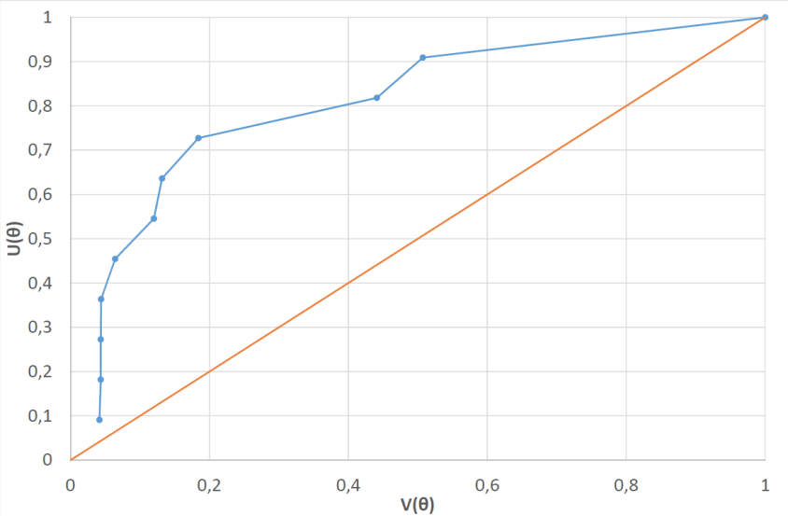
Forecast probabilities
Volume of alarm V | Number of correct forecasts | Forecast probability U | U/V
0.05 | 1 | 0.1 | 2
0.1 | 4 | 0.4 | 4
0.15 | 5 | 0.5 | 3.3
0.2 | 7 | 0.7 | 3.5
Dependence of the forecast probability U on the volume of alarm V for 10 earthquakes in 2008-2018. with magnitudes M≥6.0 and depths of hypocenters H≤60 km

Slide 32
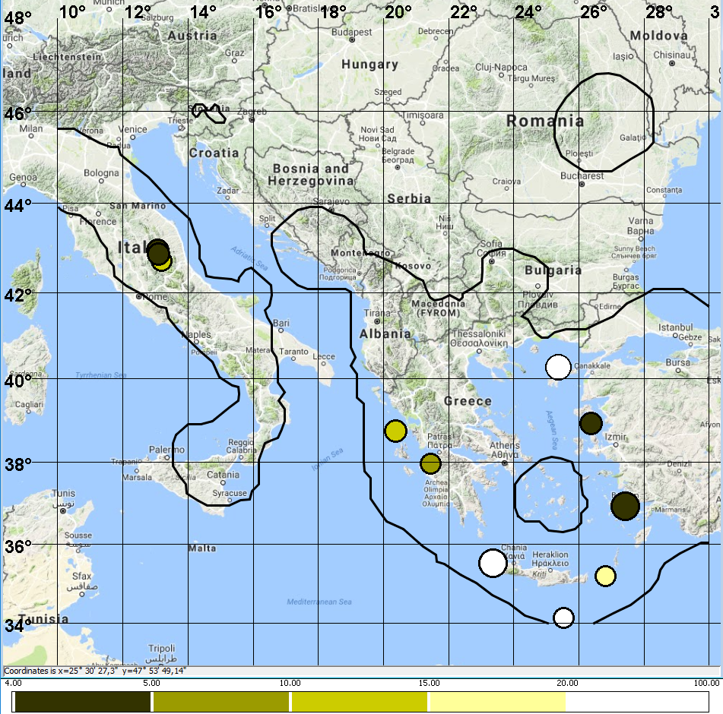
Predictable earthquake epicenters in 2008-2018.
The intensity of the fill tone decreases with increasing volume of the alarm, at which the epicenter is predicted: 0.05, 0.1, 0,15, 0.2.
White color: the earthquake is predicted with an alarm volume of more than 0.2.

Slide 33
Testing
The frames are taken with the interval of 34 days and 18 hours.
Epicenters of earthquakes are shown in the interval of 151 days.

Slide 34
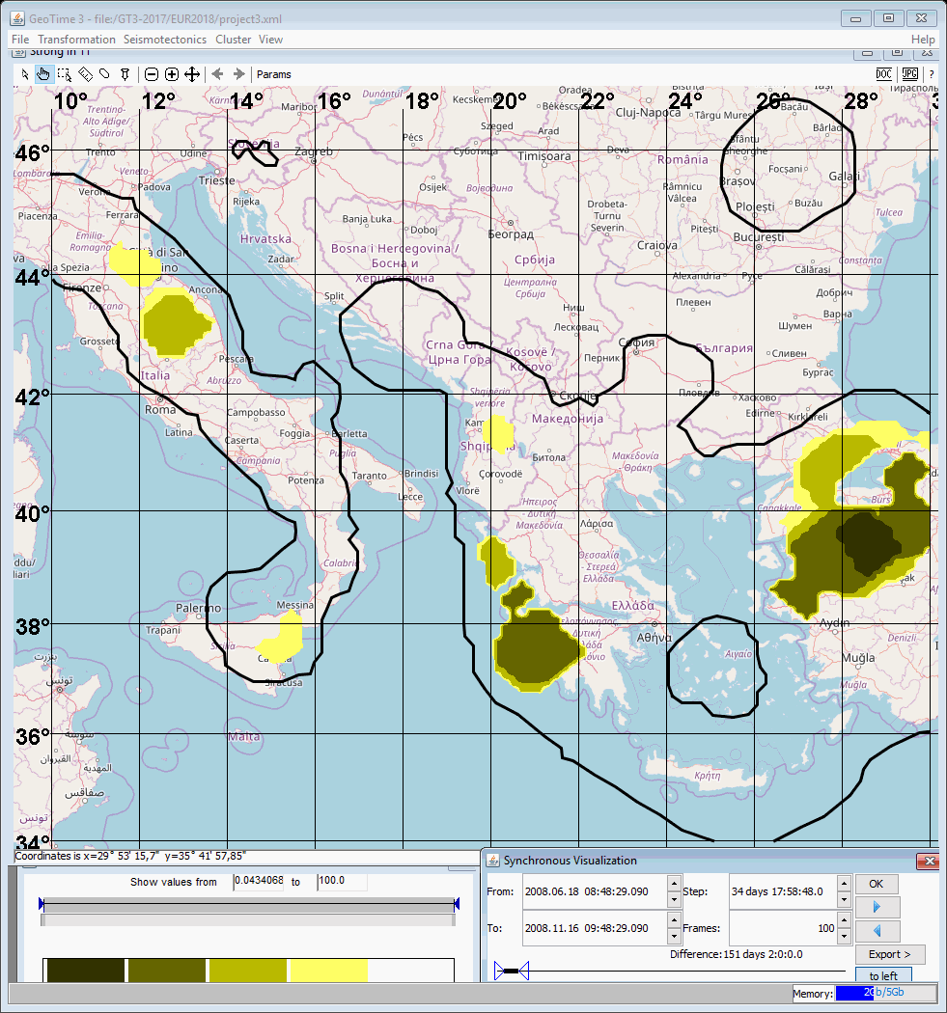

Slide 35
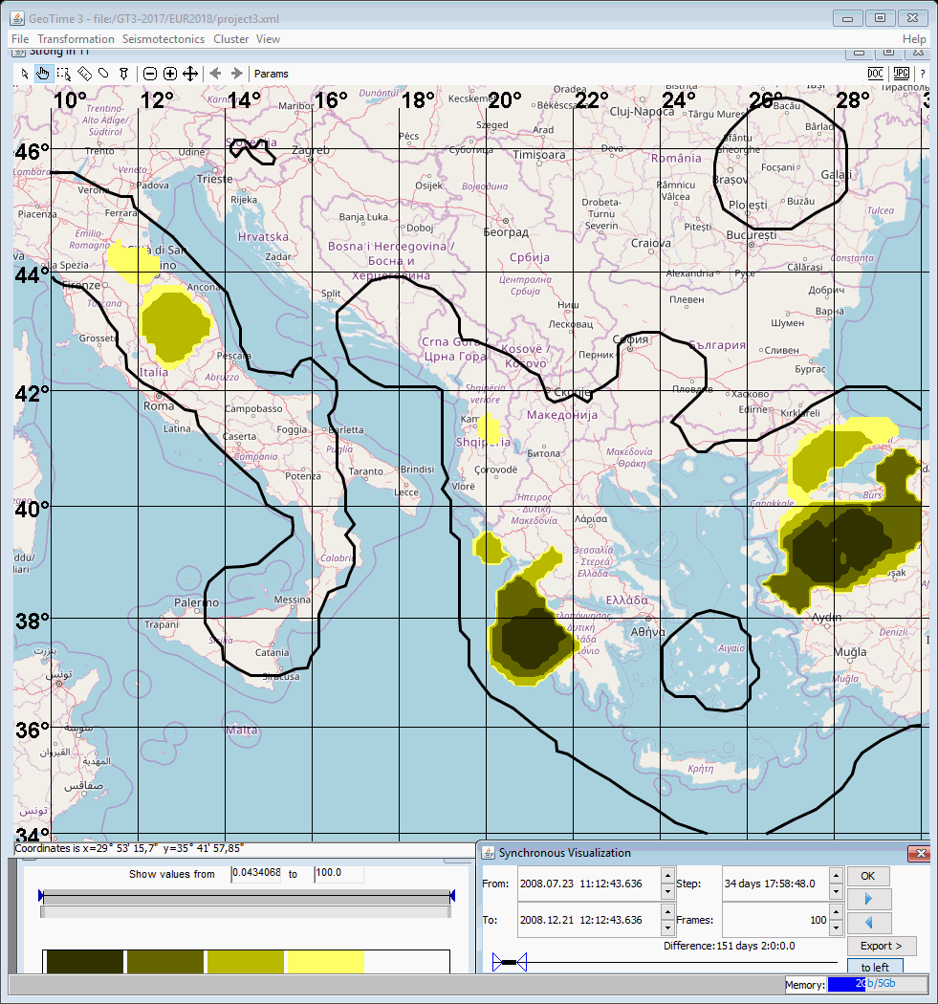

Slide 36


Slide 37
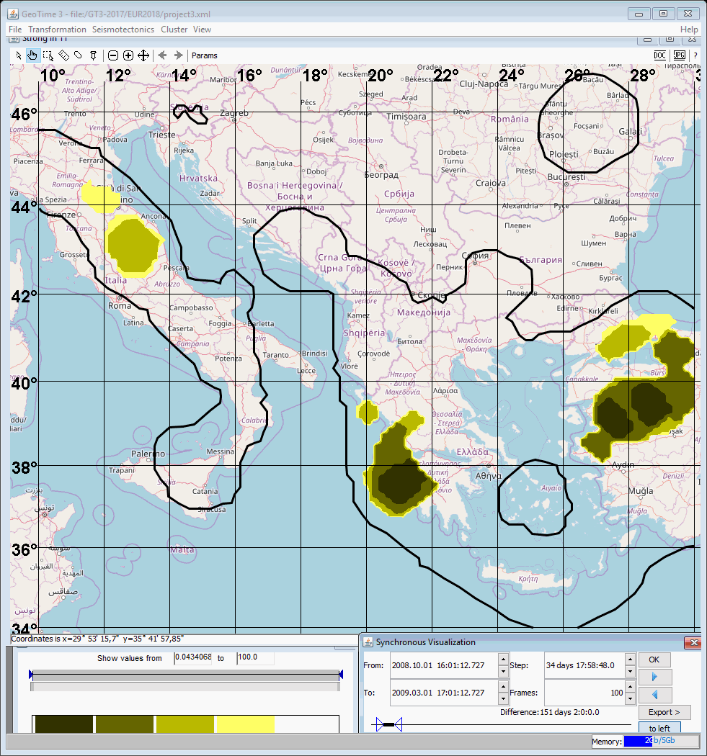

Slide 38


Slide 39
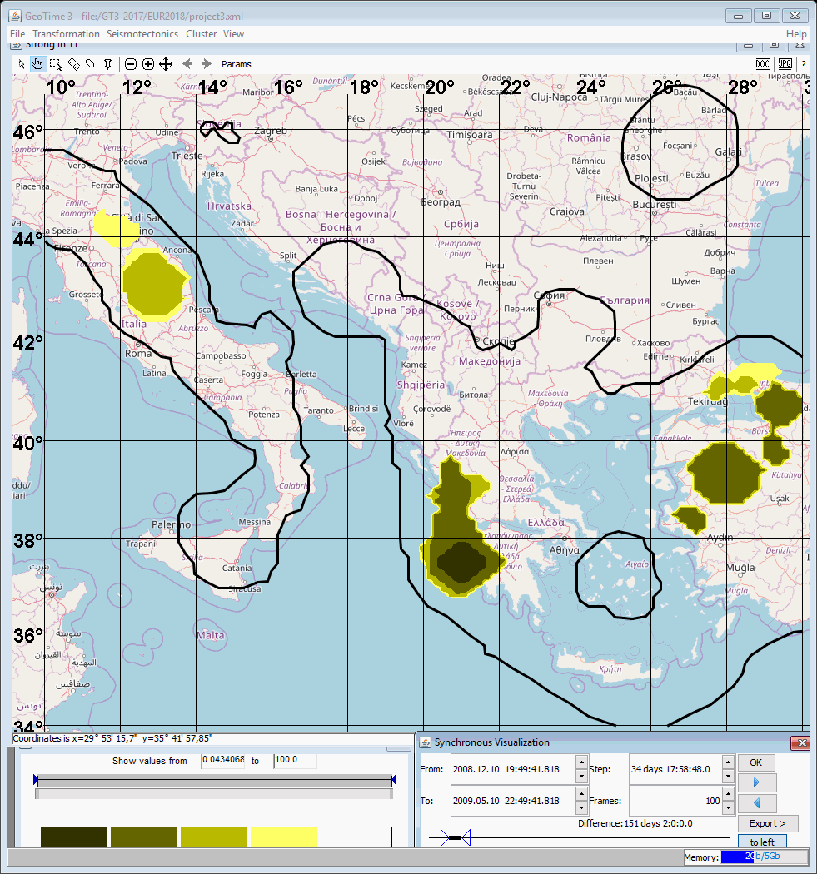

Slide 40


Slide 41
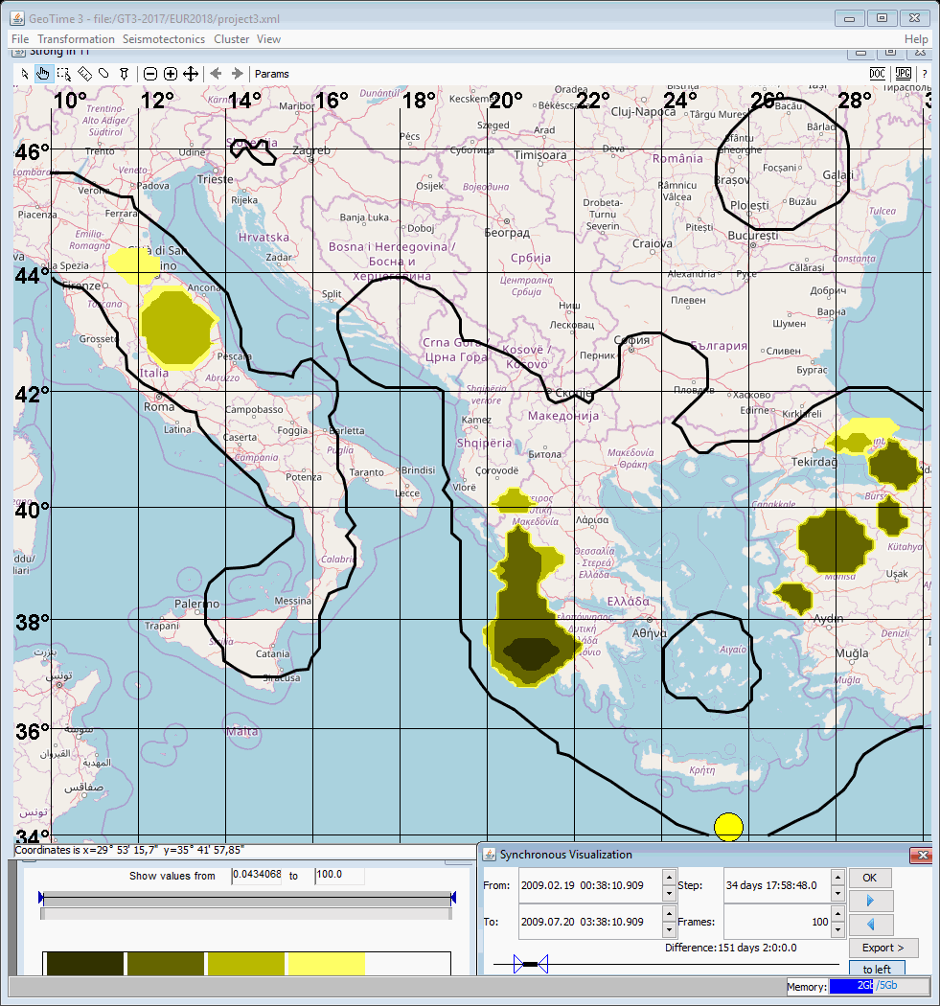

Slide 42
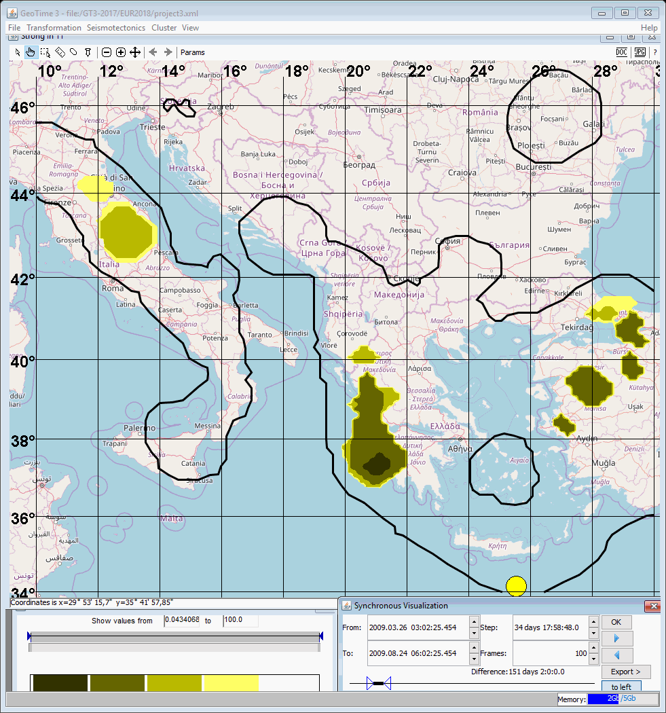

Slide 43


Slide 44
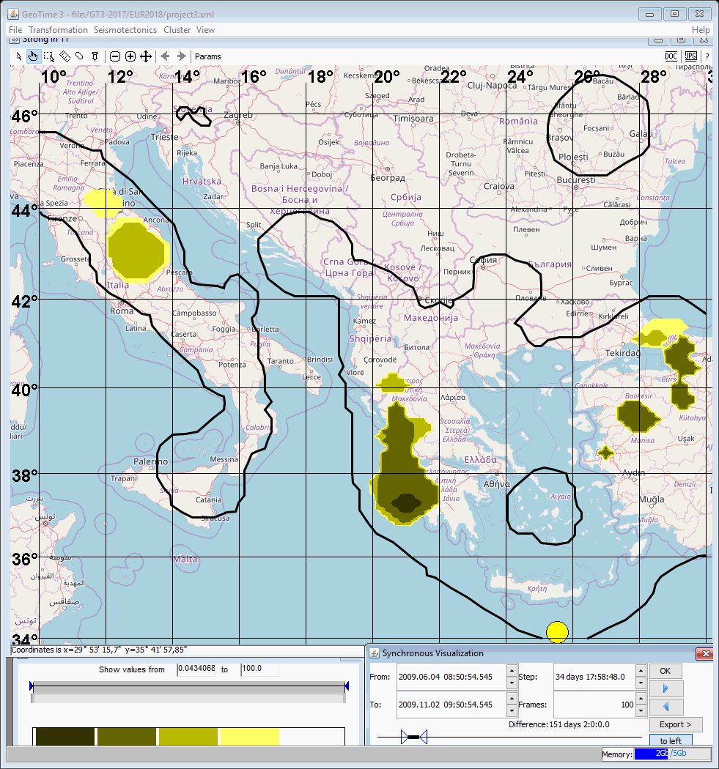

Slide 45
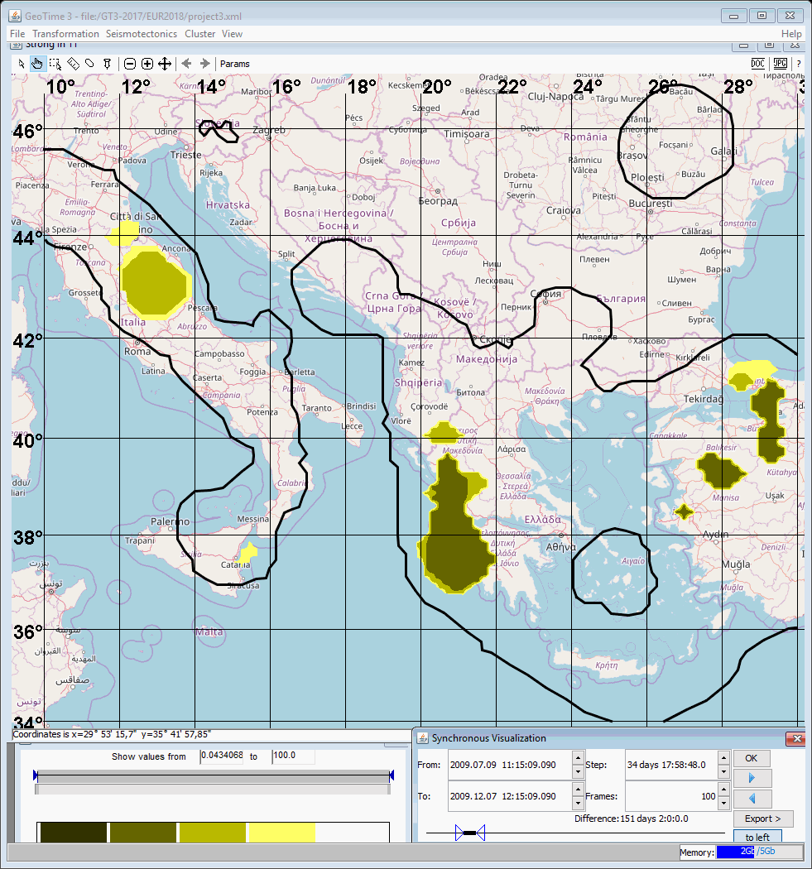

Slide 46


Slide 47


Slide 48
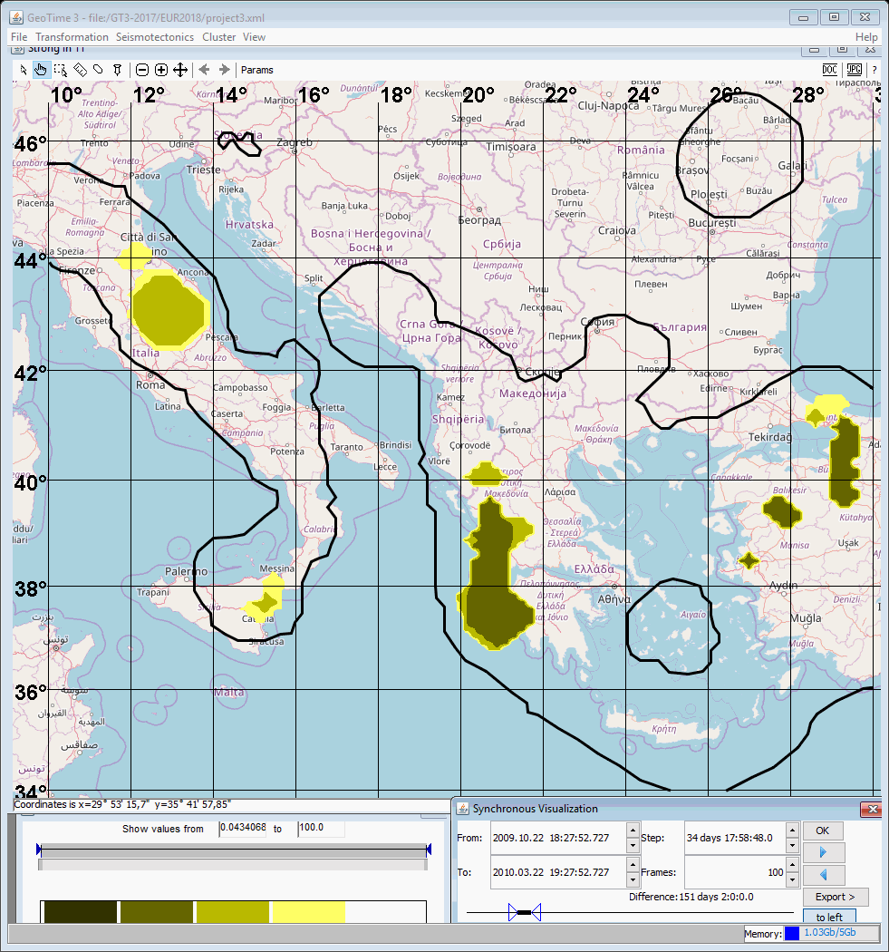

Slide 49
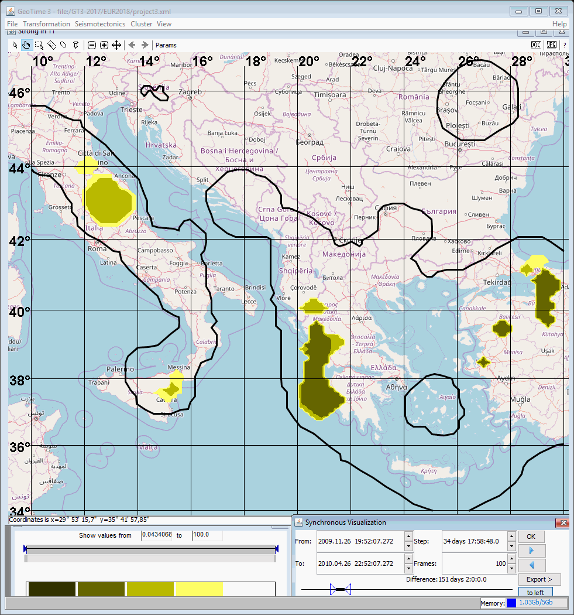

Slide 50


Slide 51


Slide 52
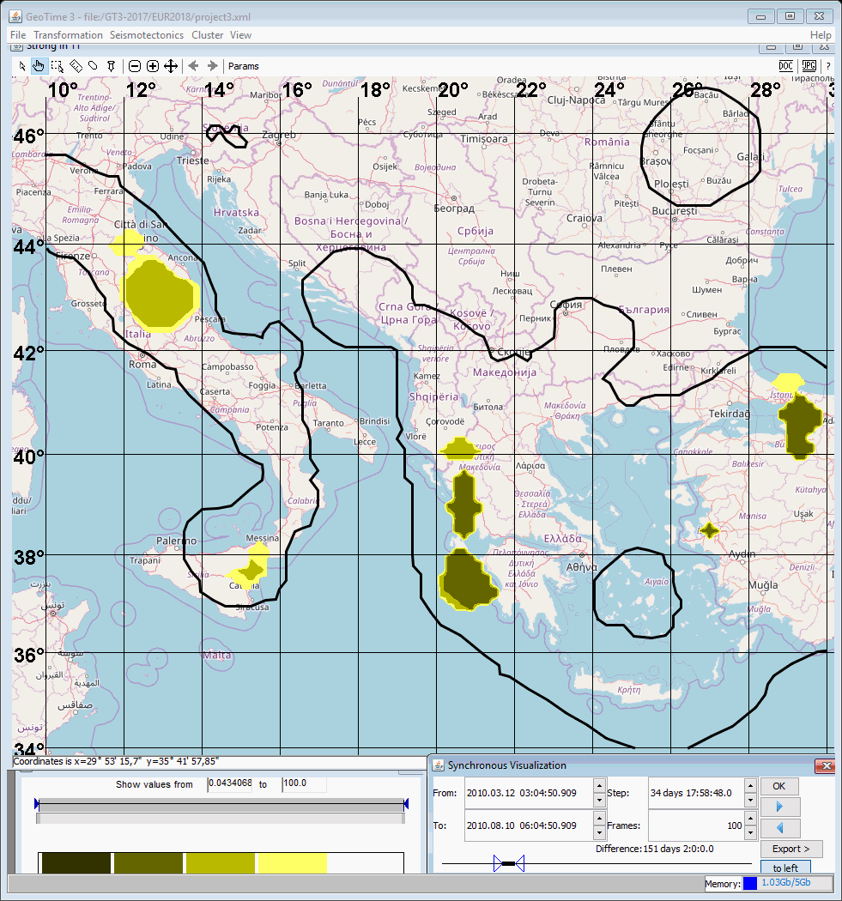

Slide 53
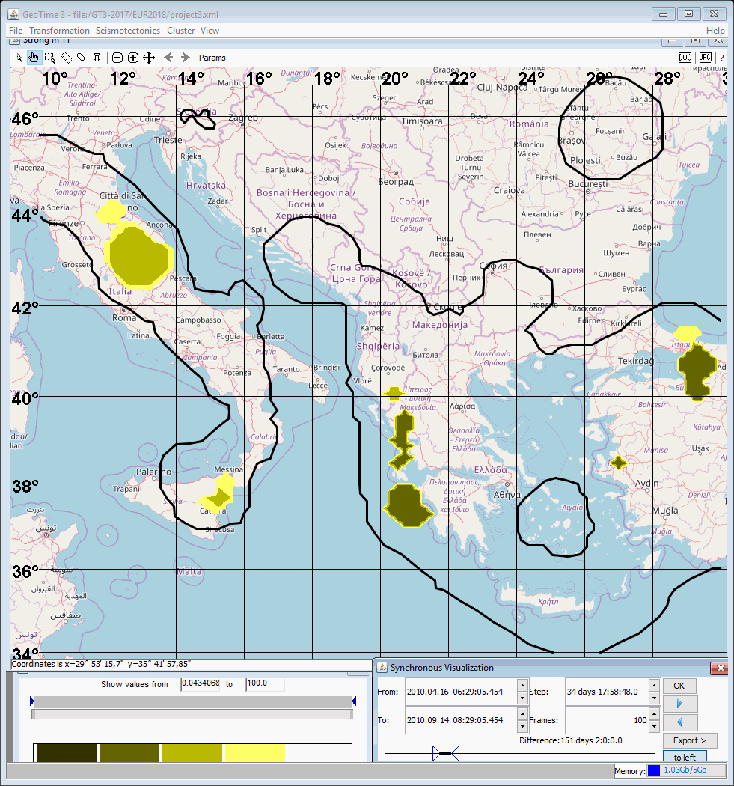

Slide 54


Slide 55
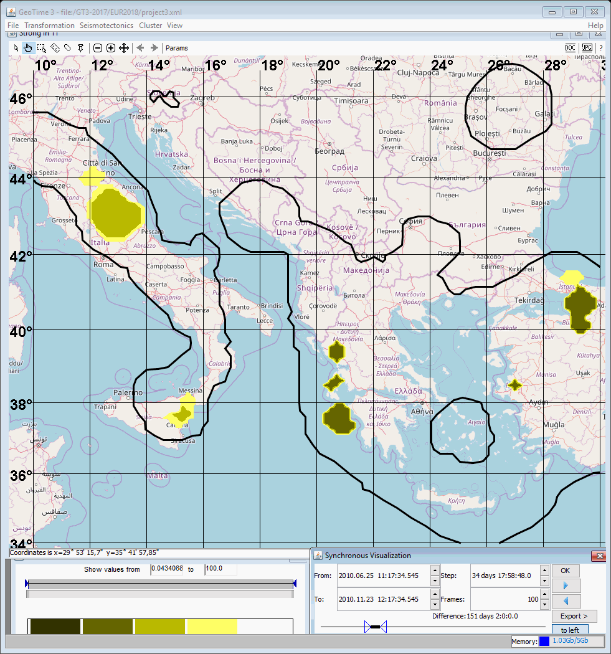

Slide 56
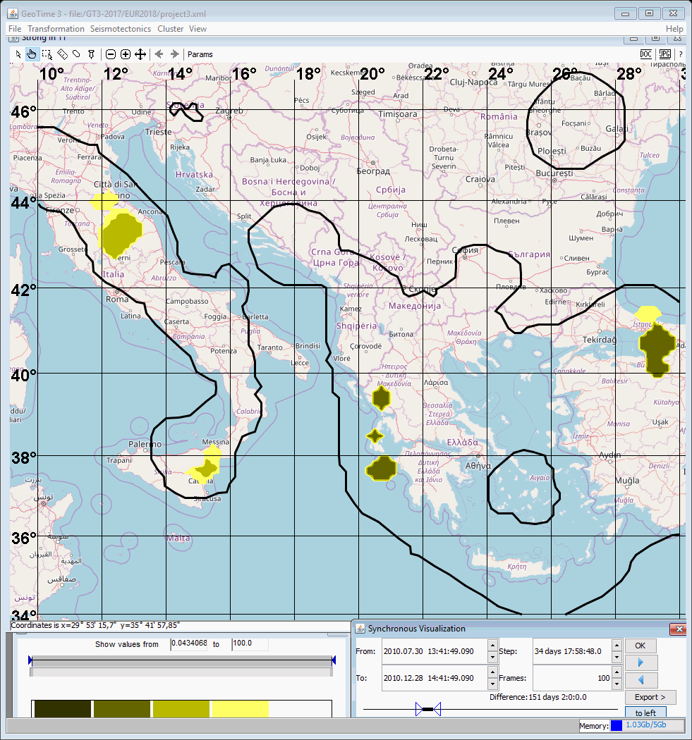

Slide 57
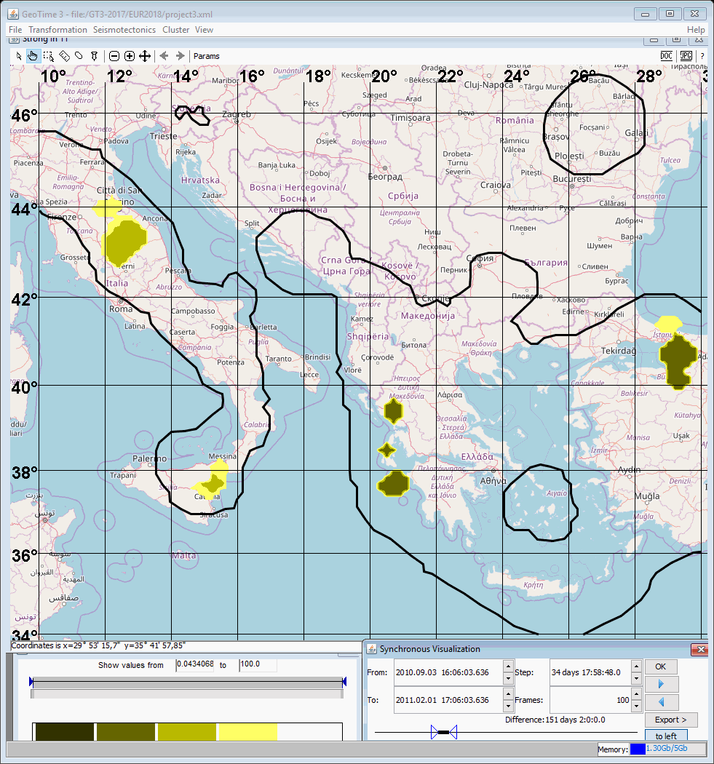

Slide 58
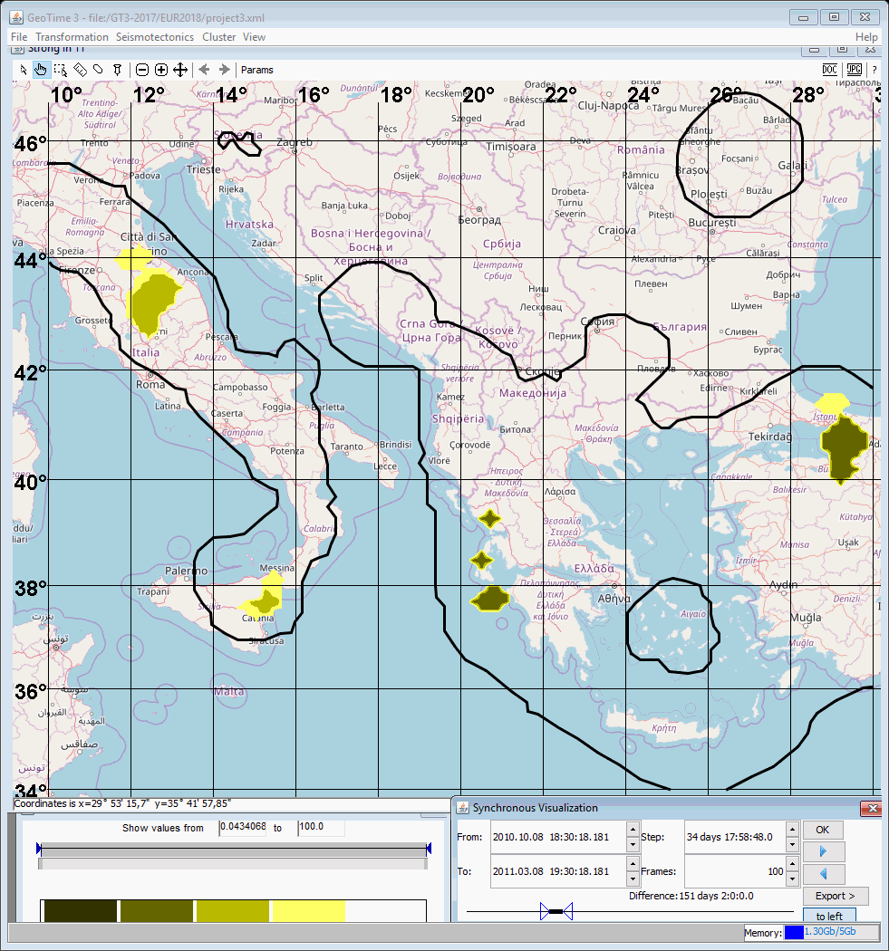

Slide 59


Slide 60


Slide 61


Slide 62


Slide 63


Slide 64


Slide 65


Slide 66


Slide 67


Slide 68


Slide 69
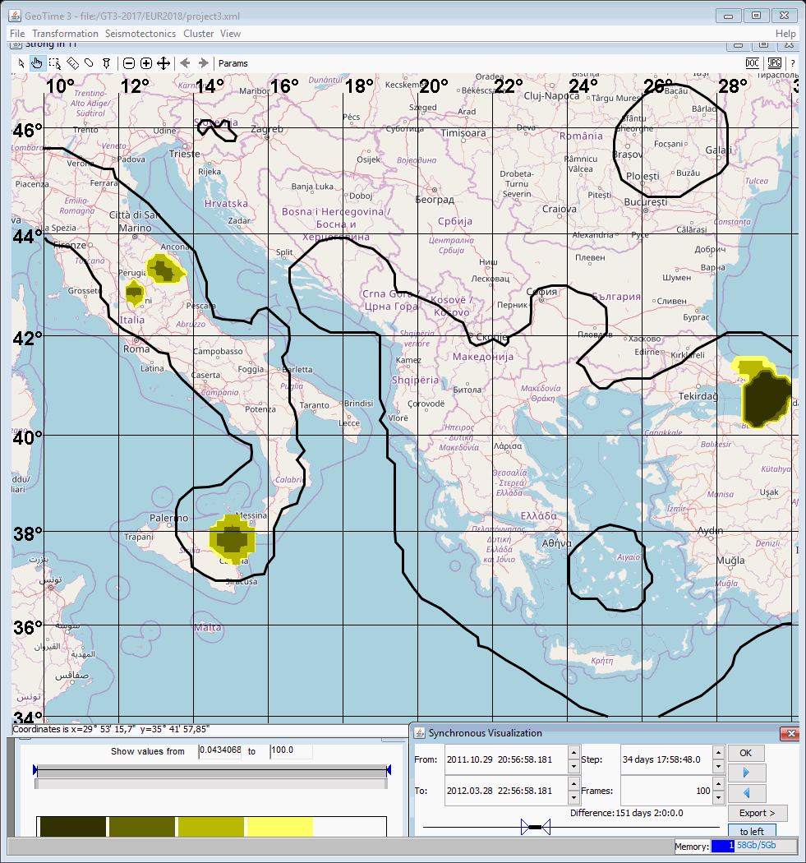

Slide 70
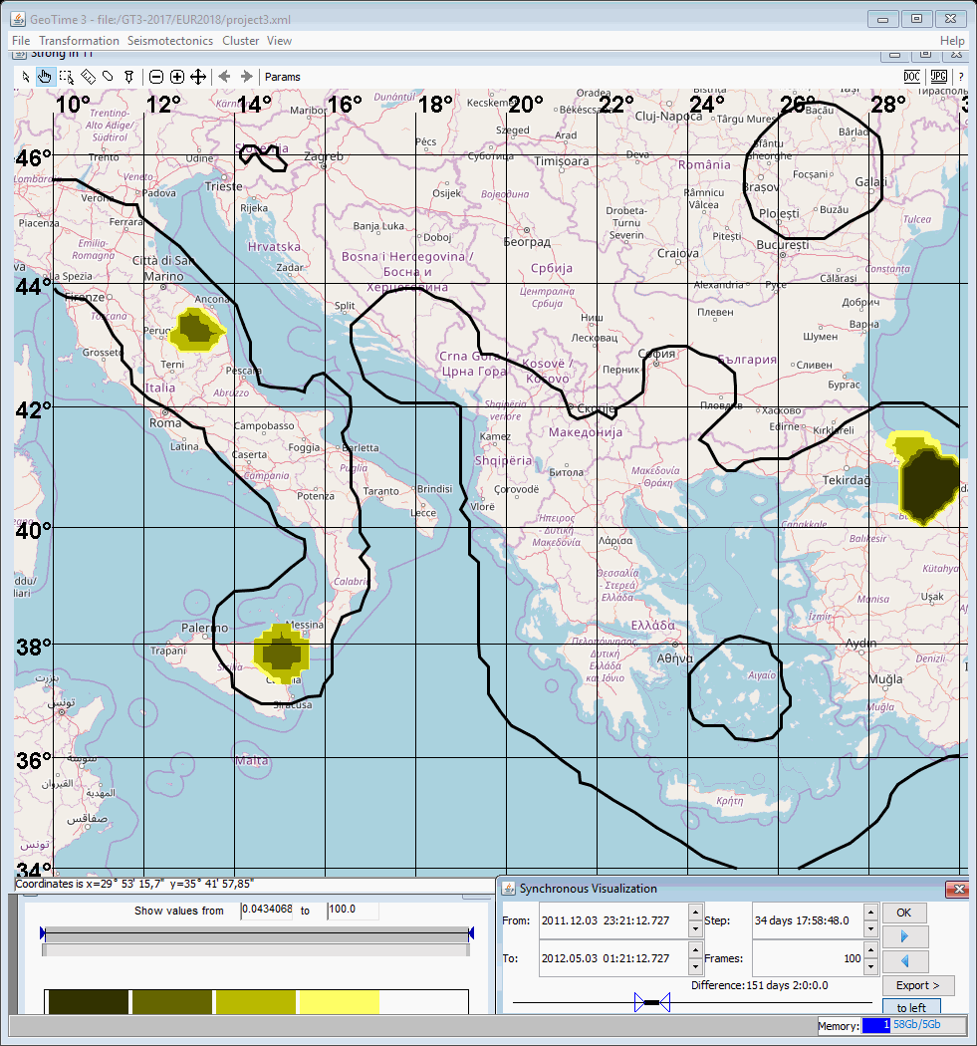

Slide 71


Slide 72
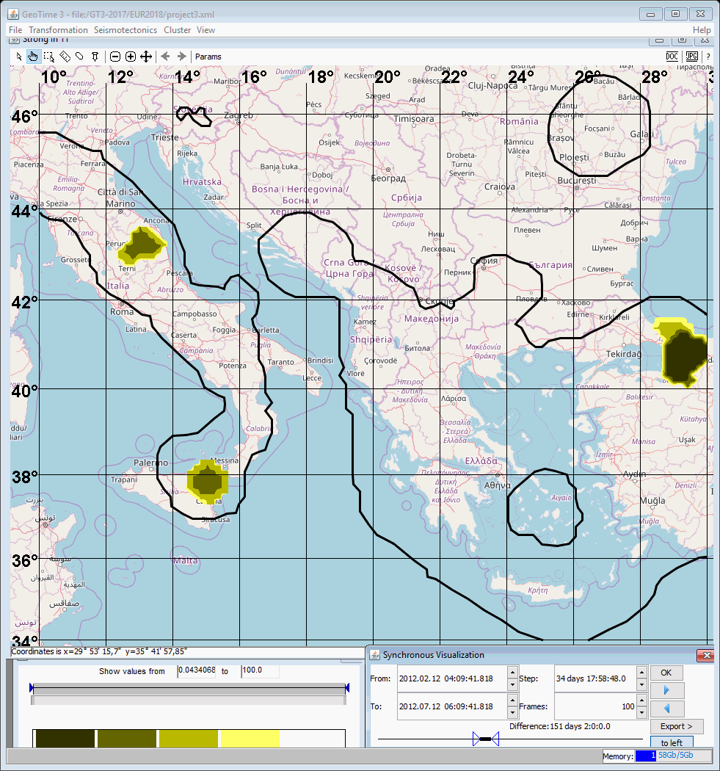

Slide 73
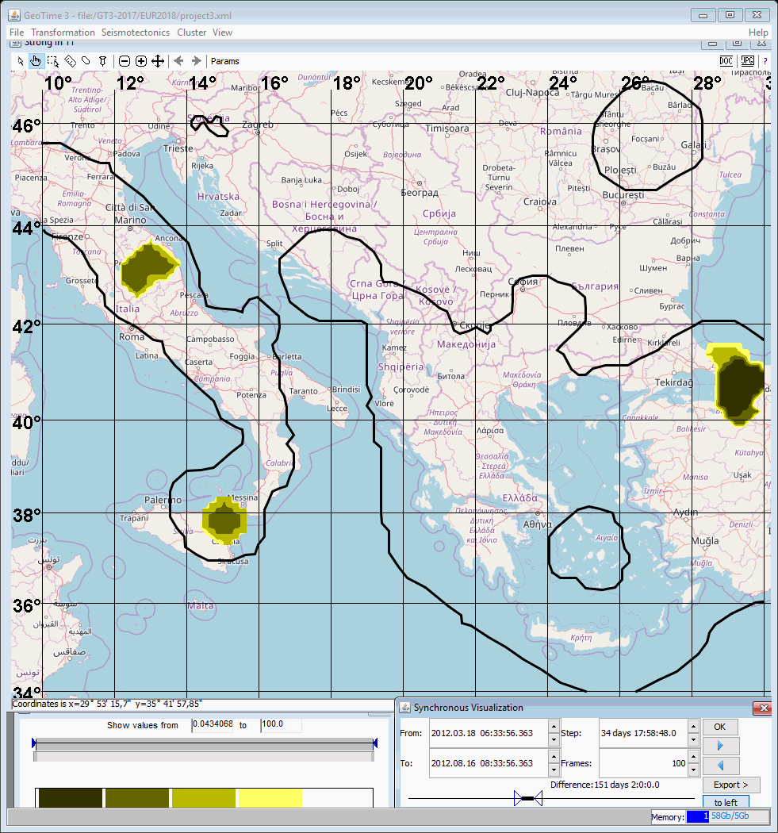

Slide 74
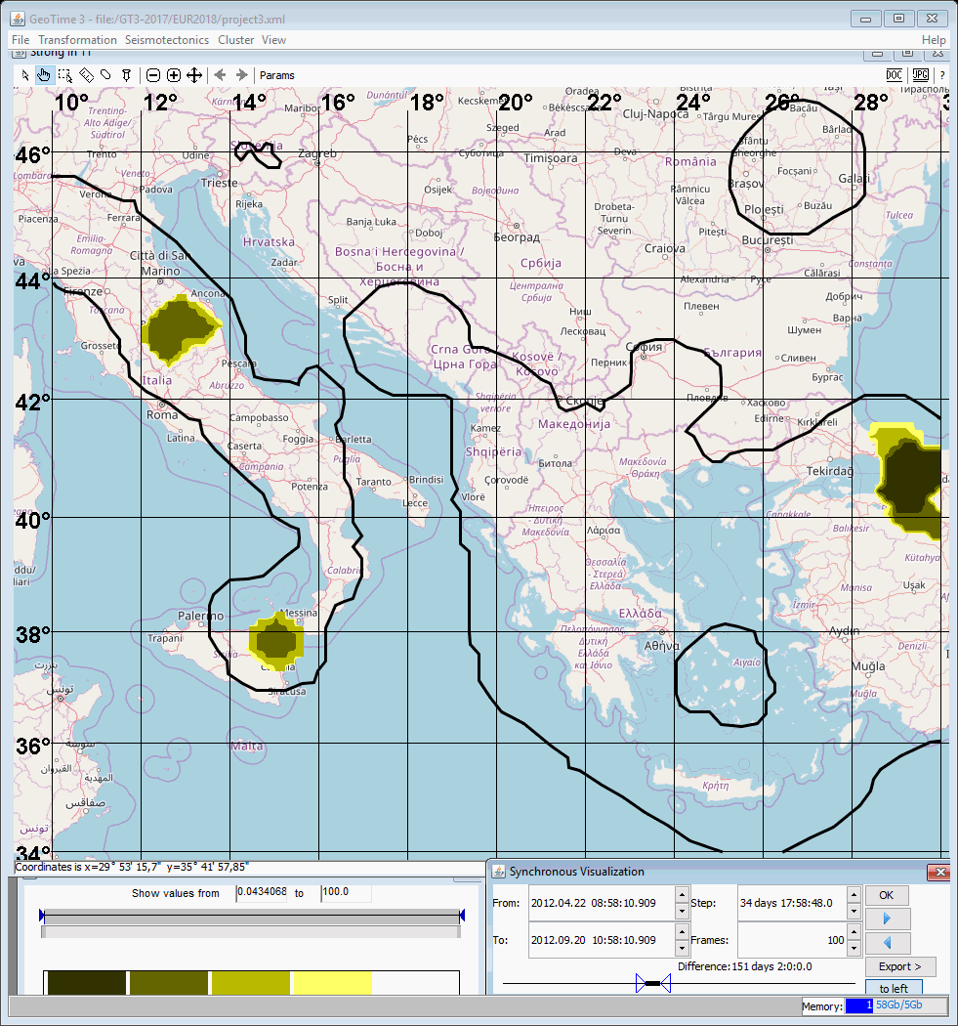

Slide 75


Slide 76
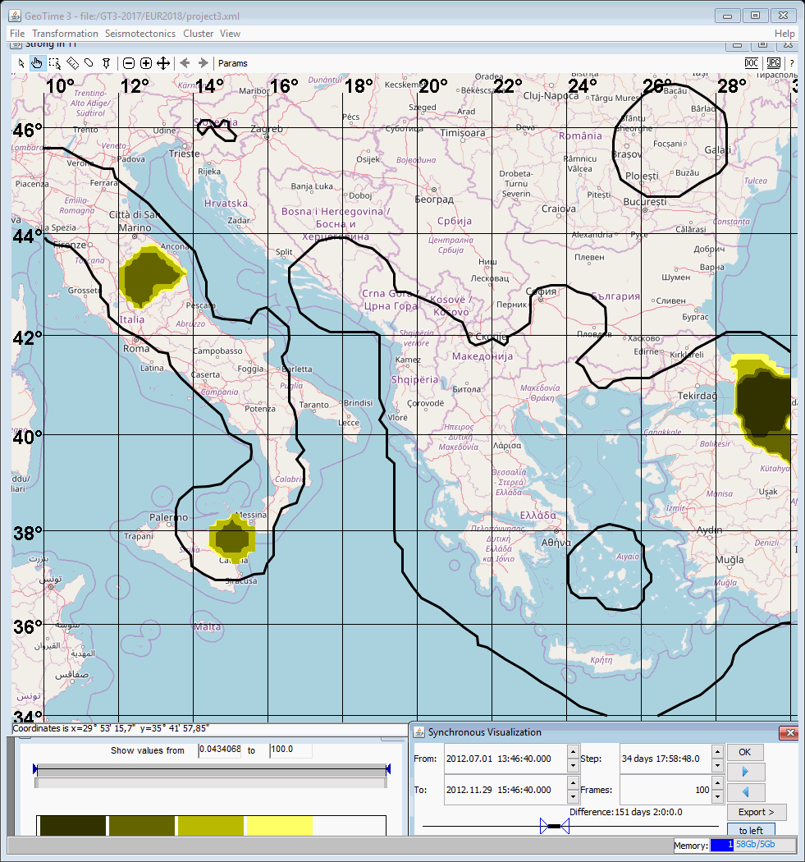

Slide 77
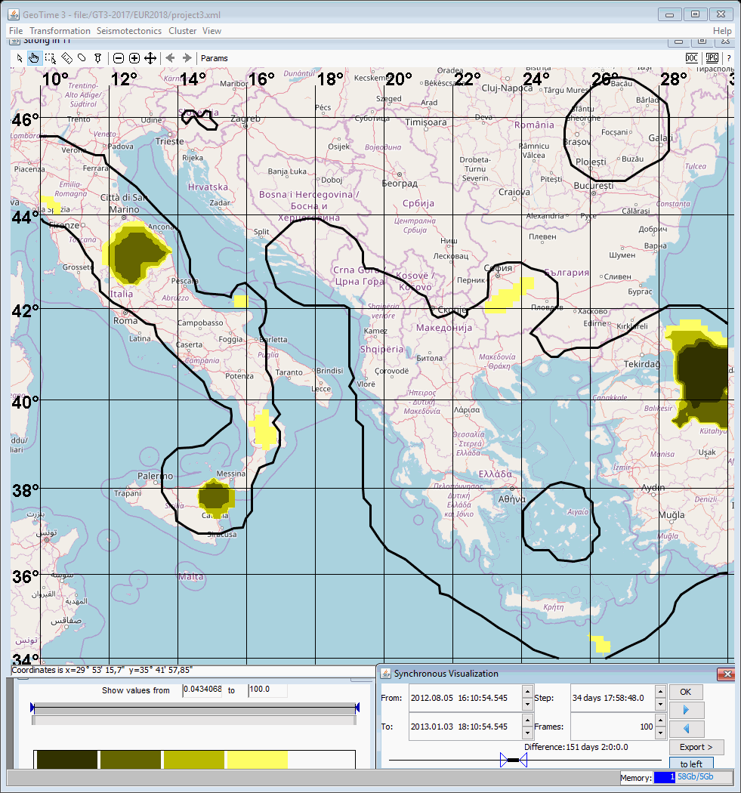

Slide 78


Slide 79
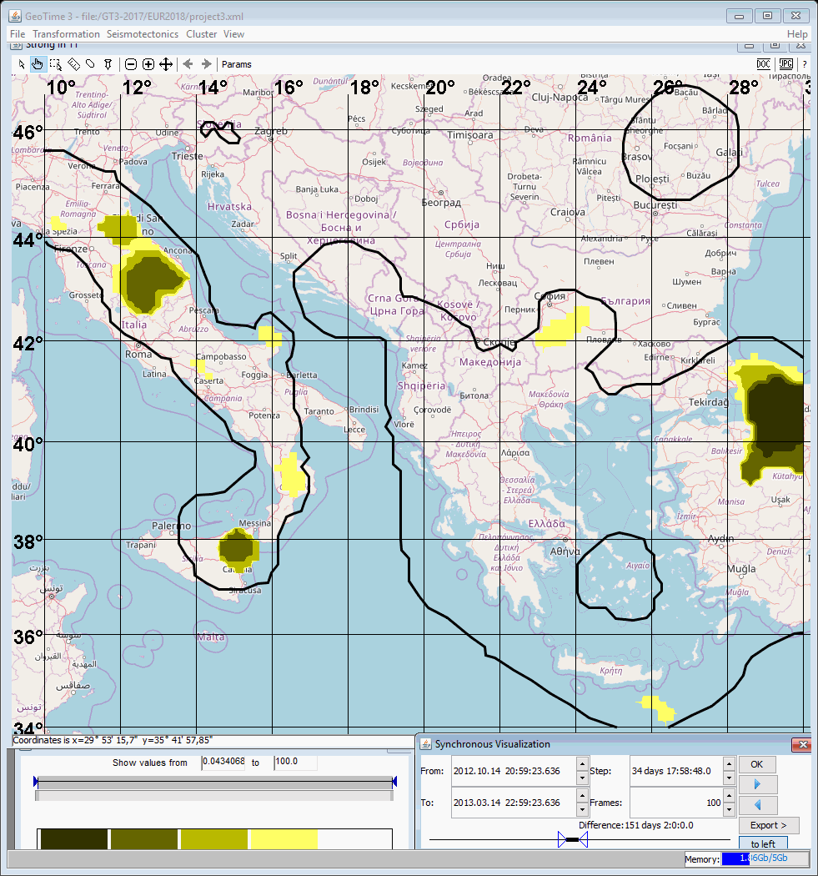

Slide 80
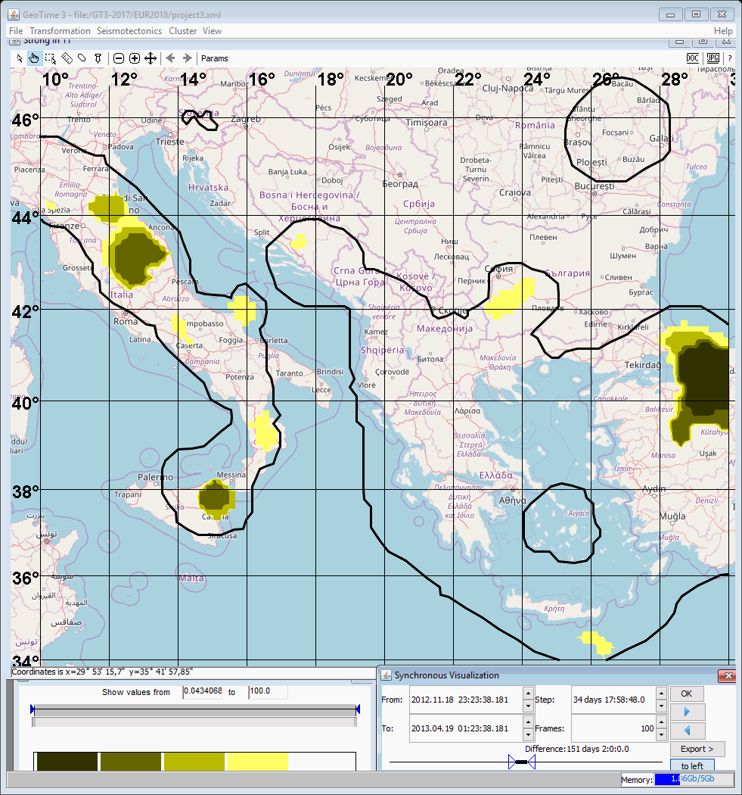

Slide 81
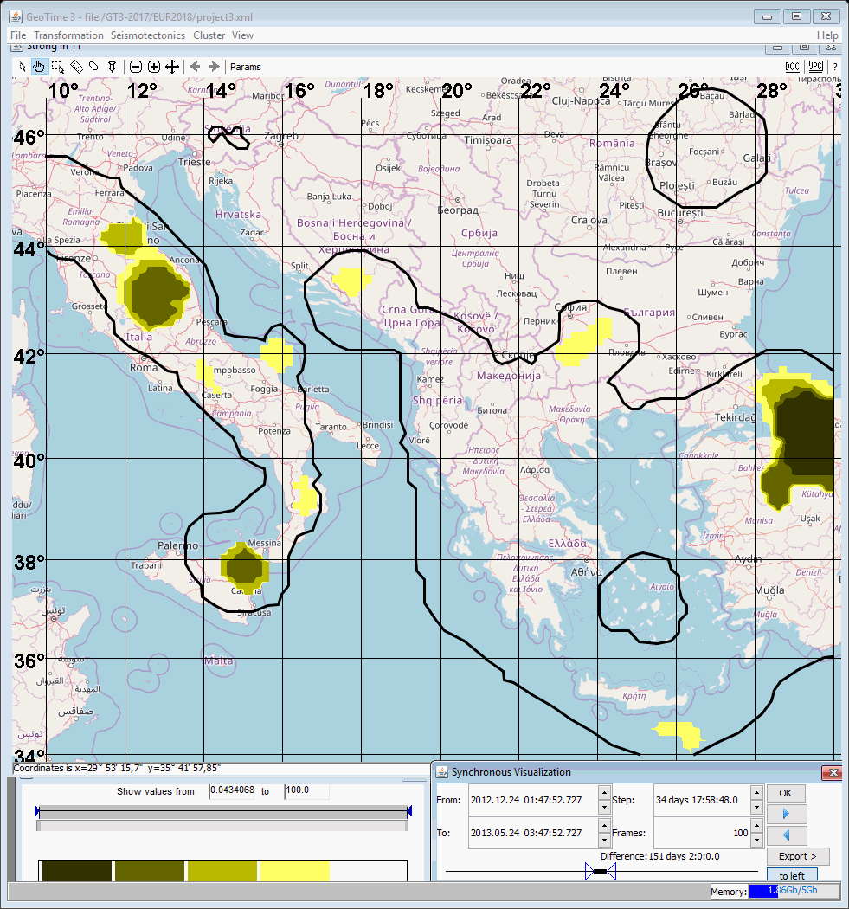

Slide 82


Slide 83
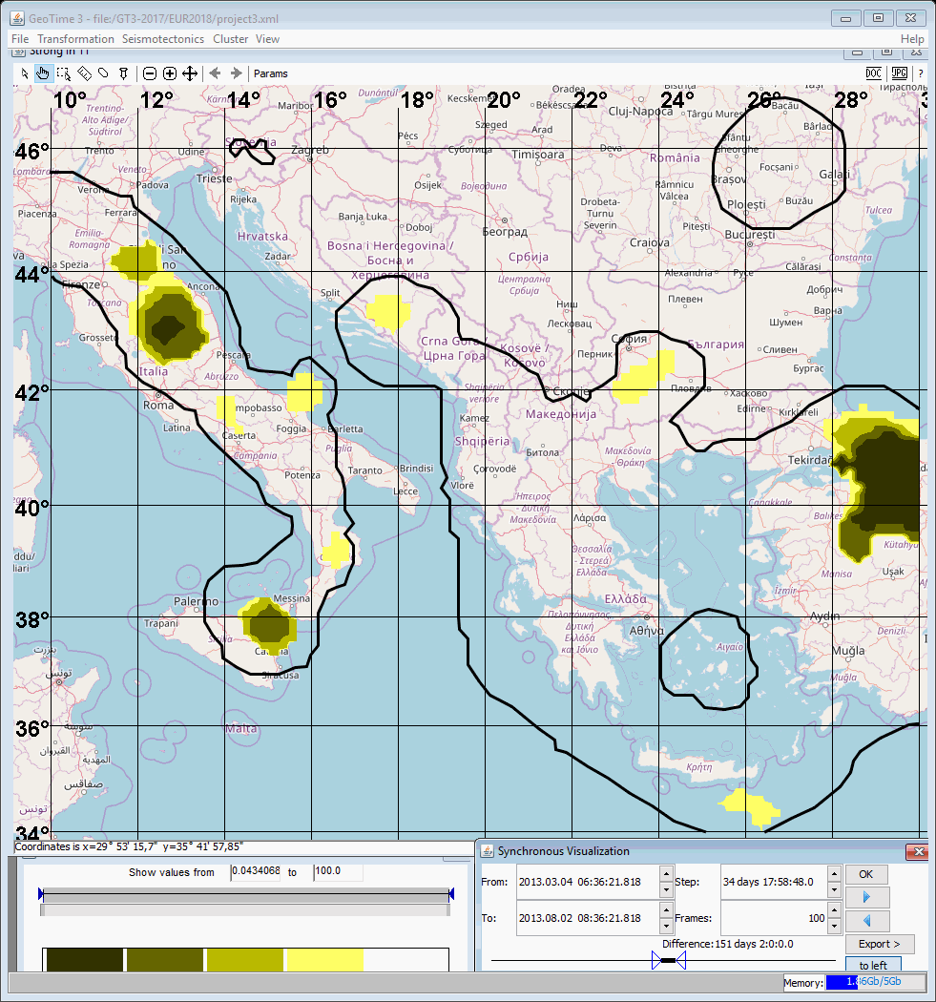

Slide 84


Slide 85


Slide 86
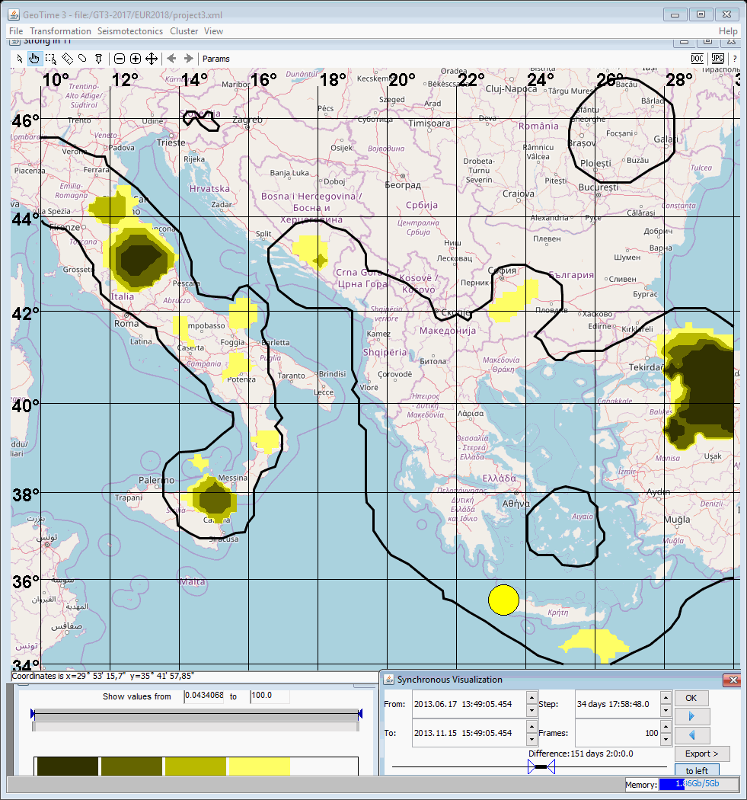

Slide 87
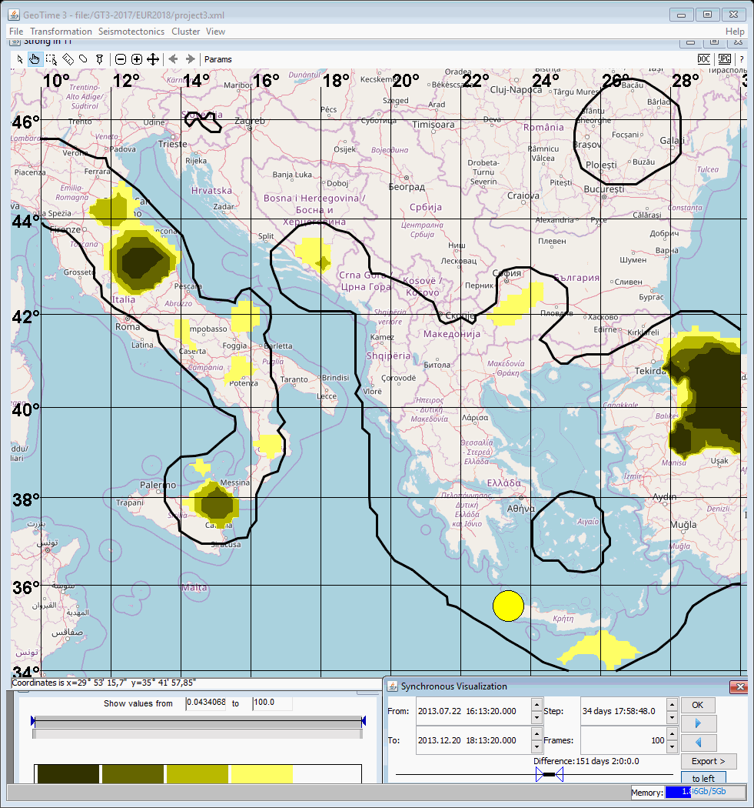

Slide 88
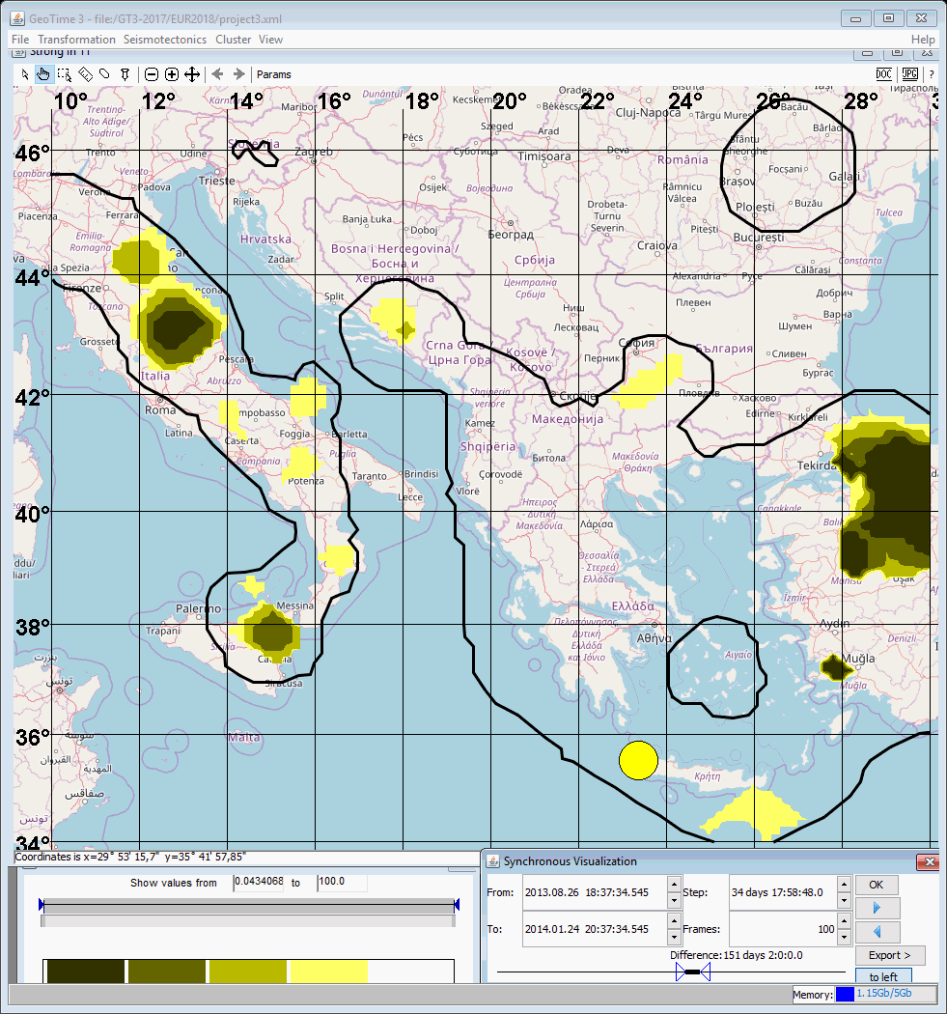

Slide 89


Slide 90
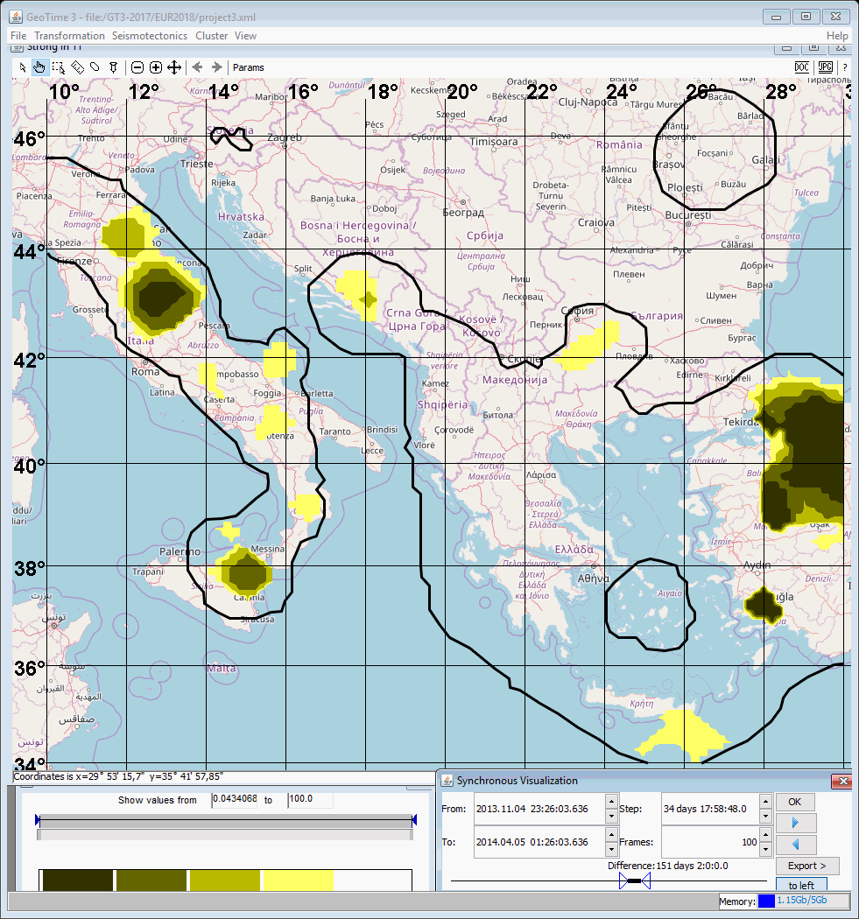

Slide 91
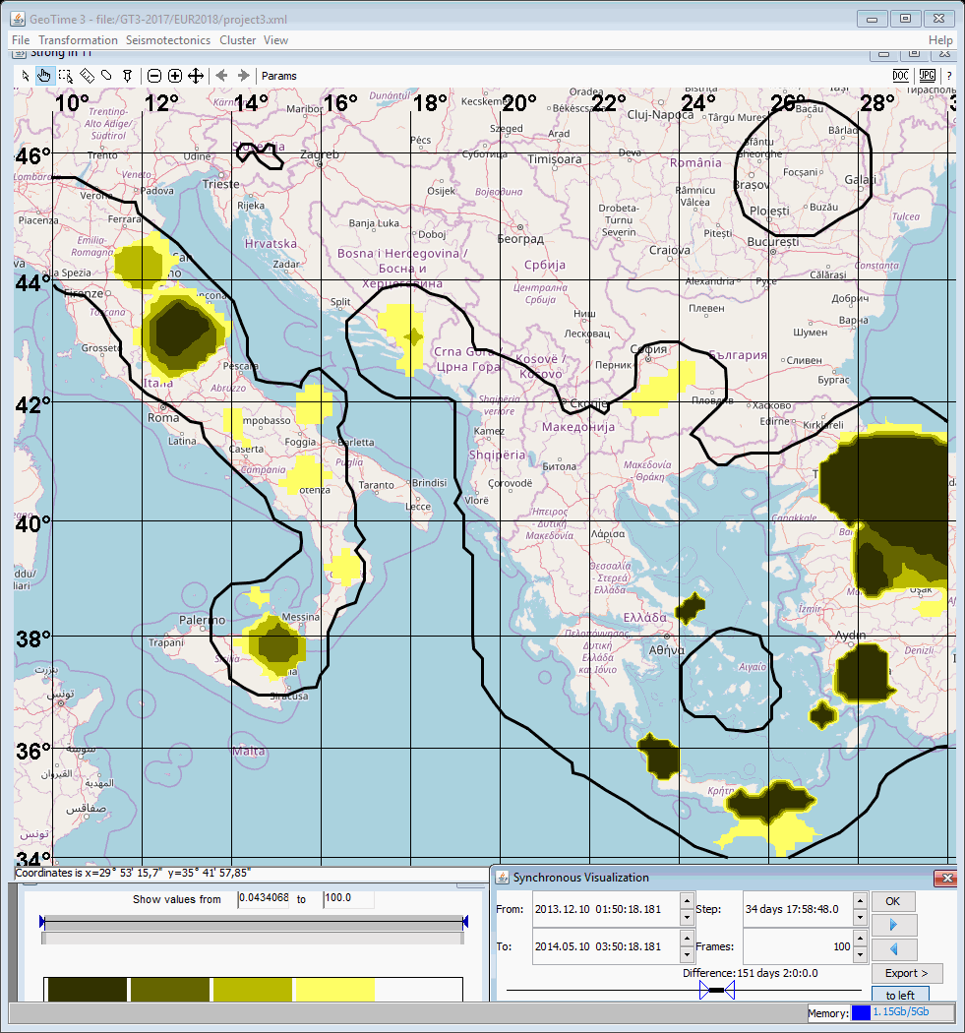

Slide 92
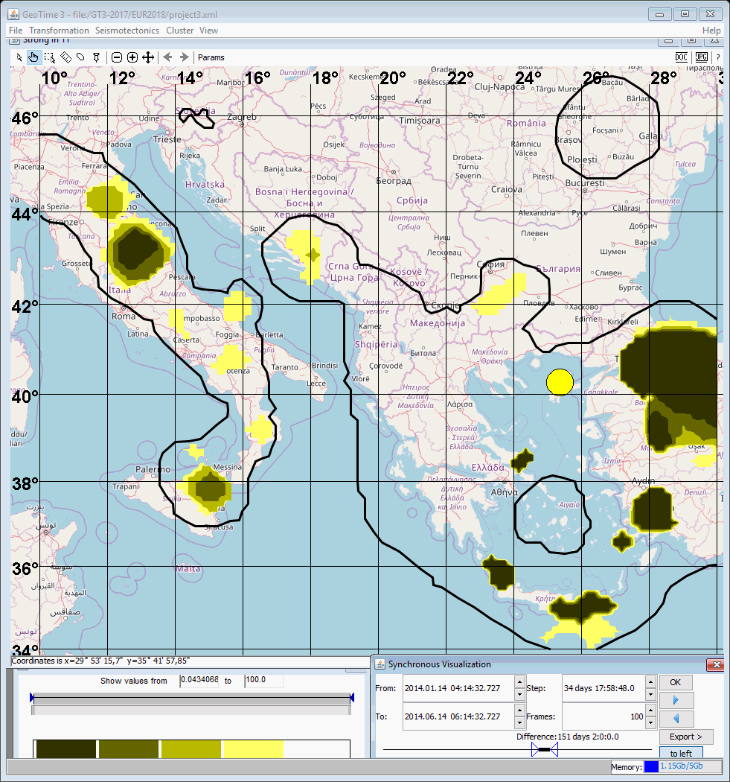

Slide 93
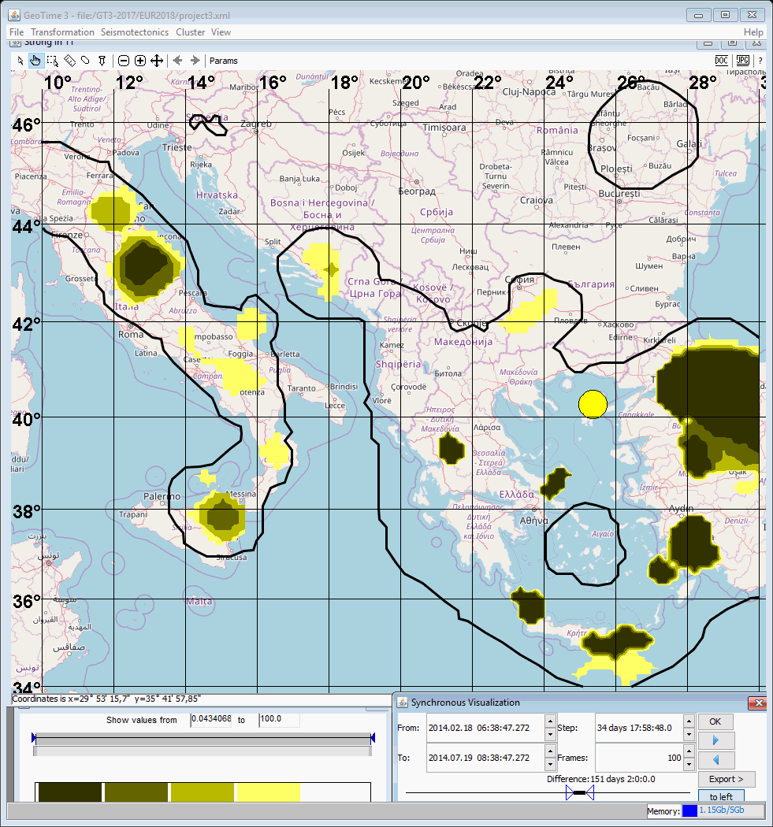

Slide 94
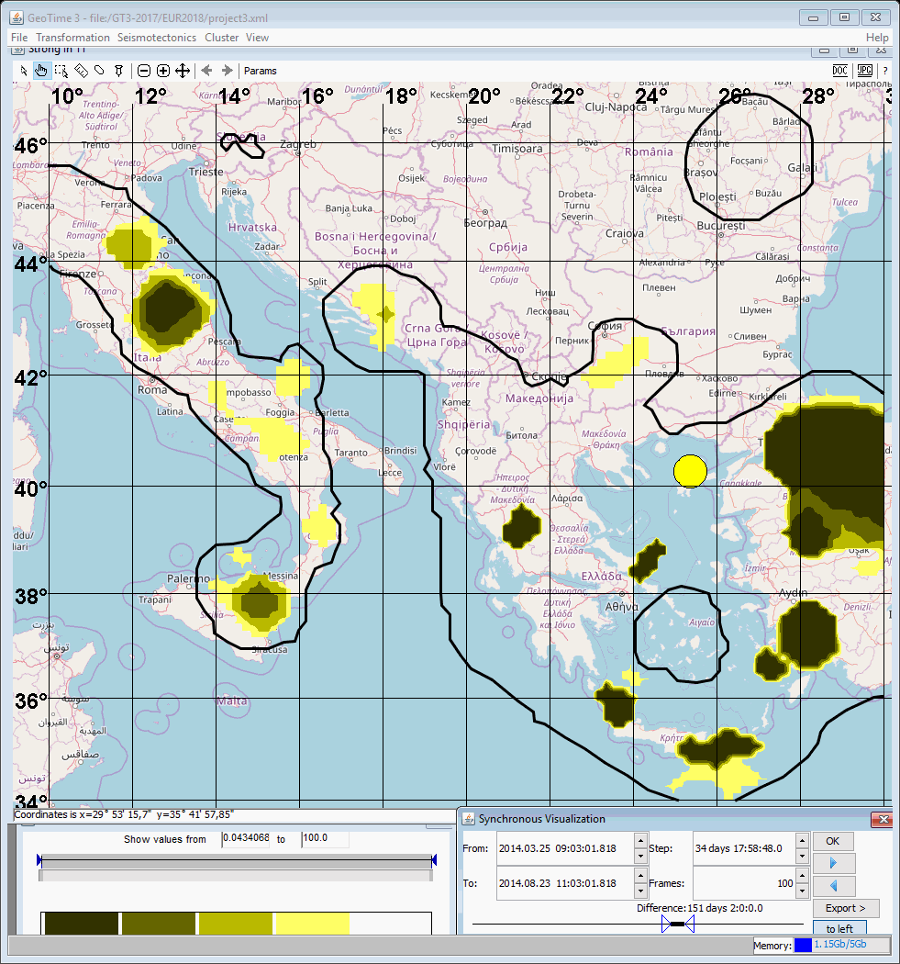

Slide 95


Slide 96
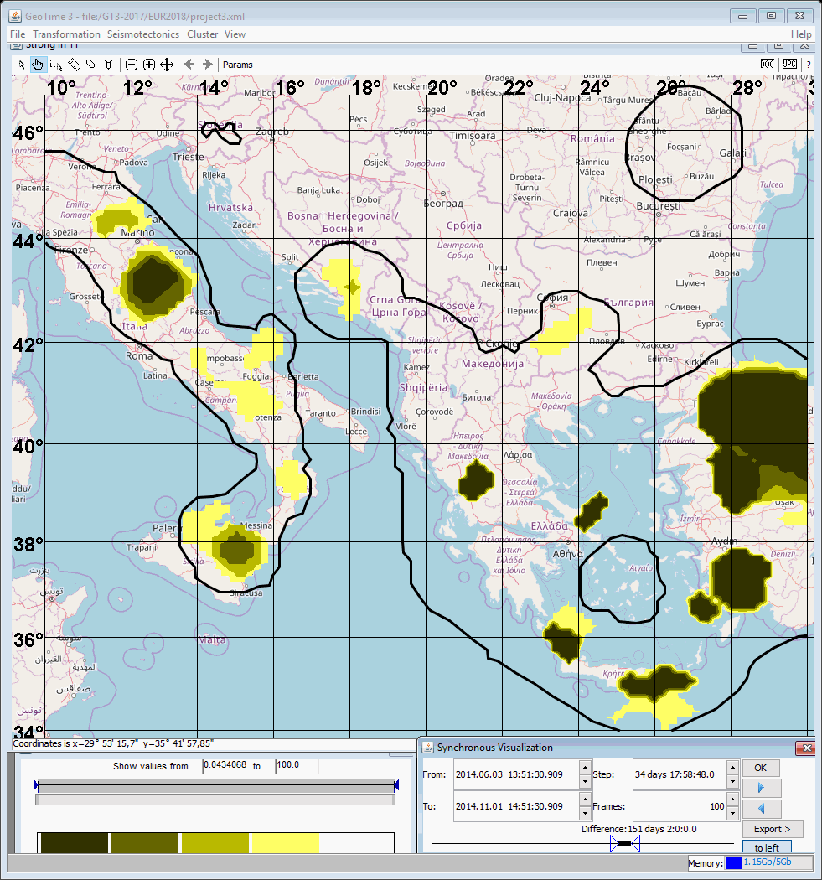

Slide 97
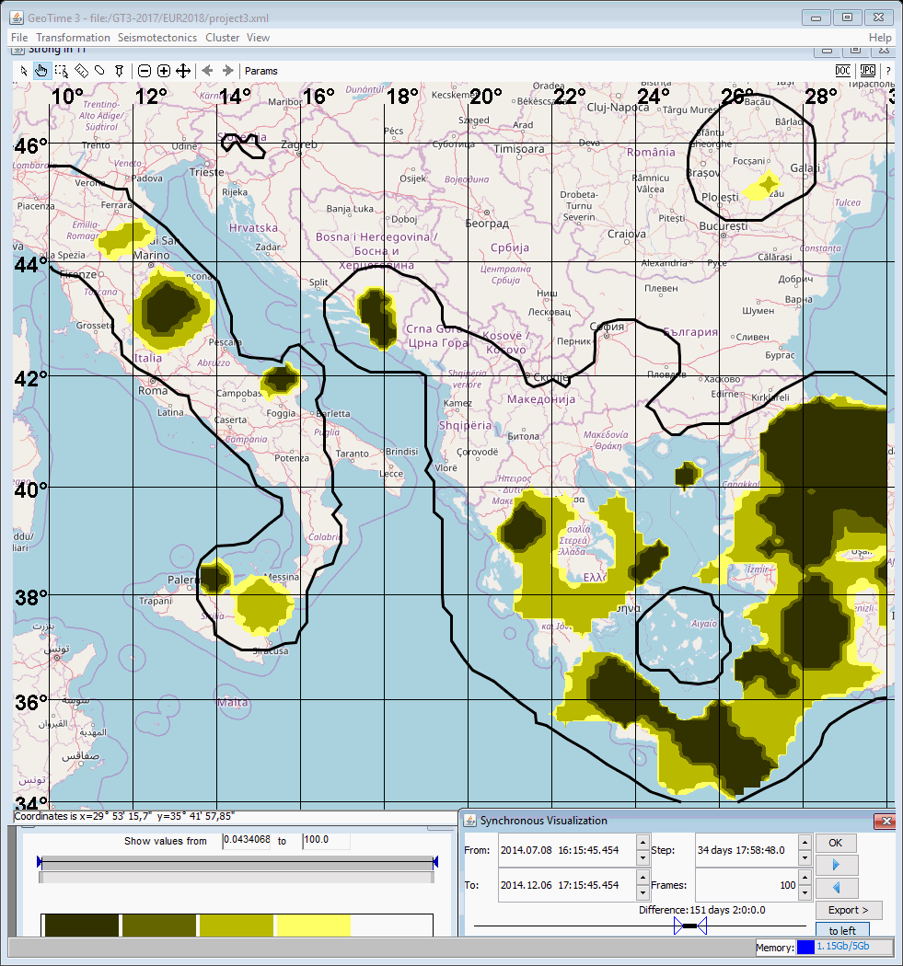

Slide 98
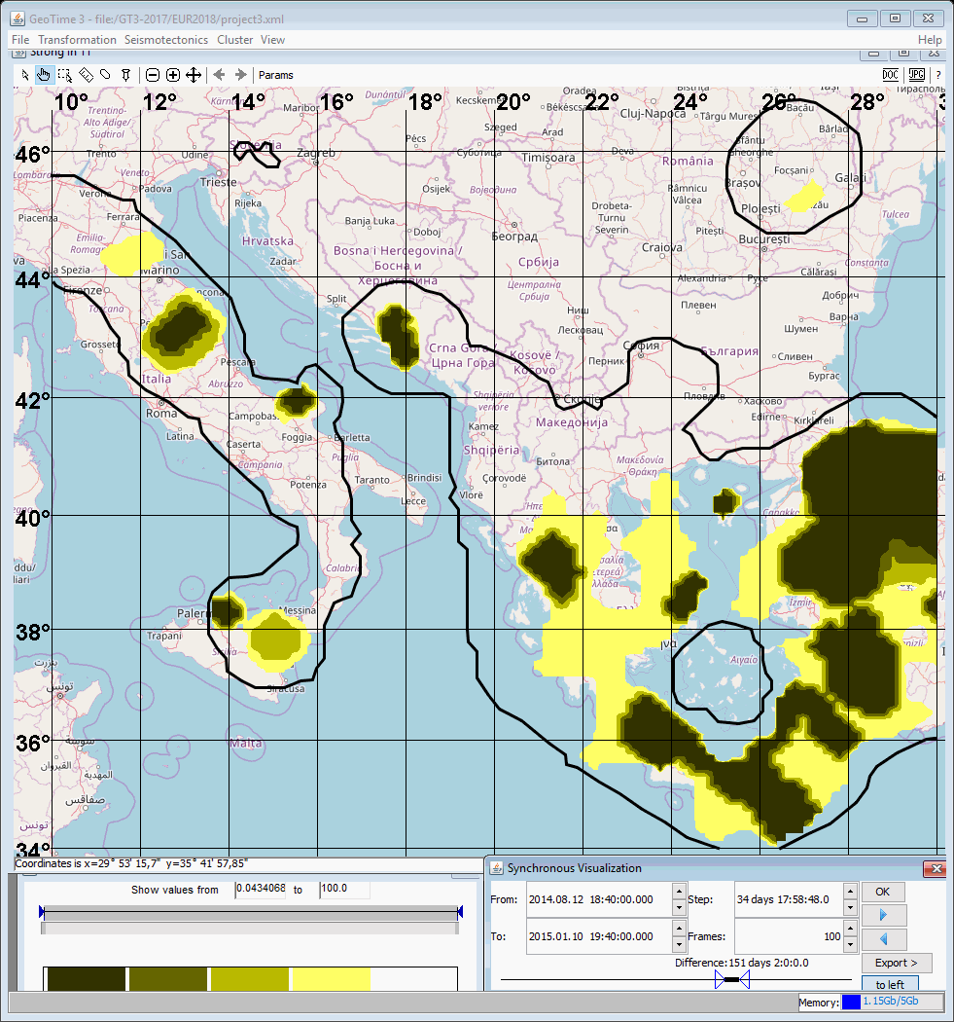

Slide 99
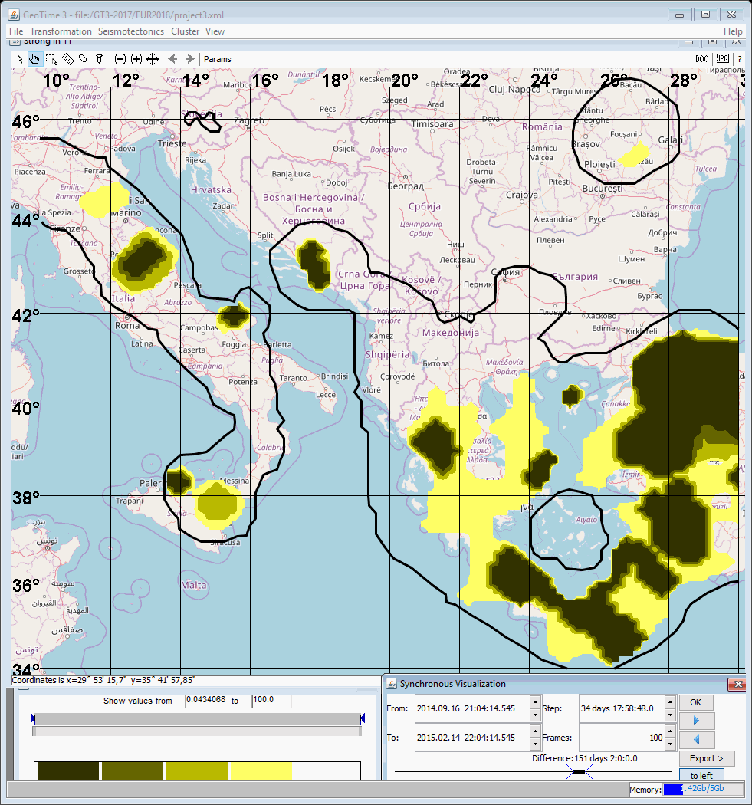

Slide 100
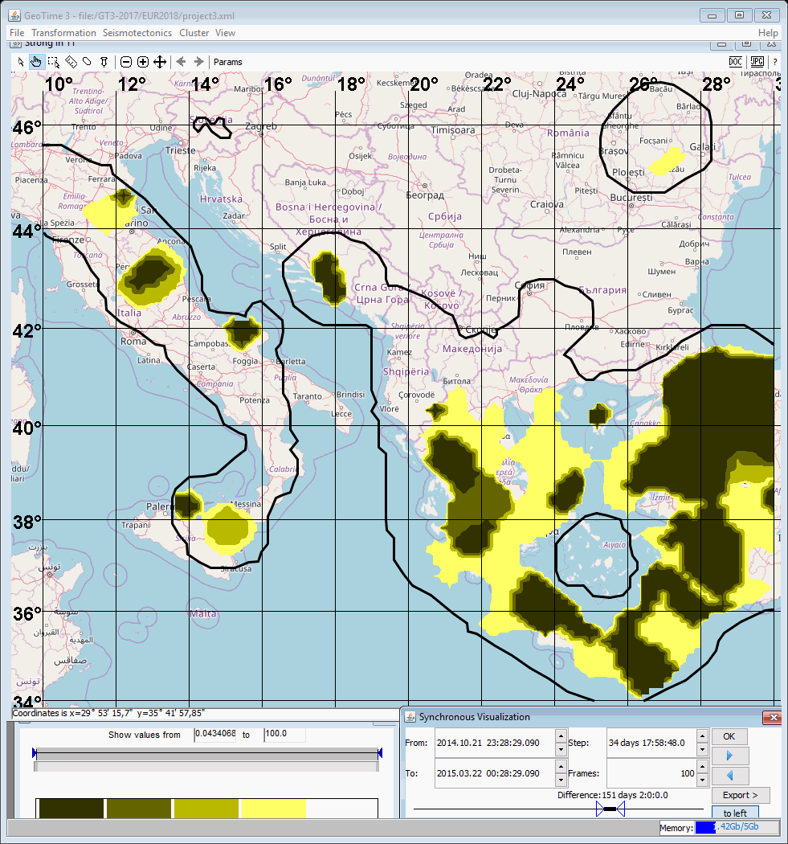

Slide 101
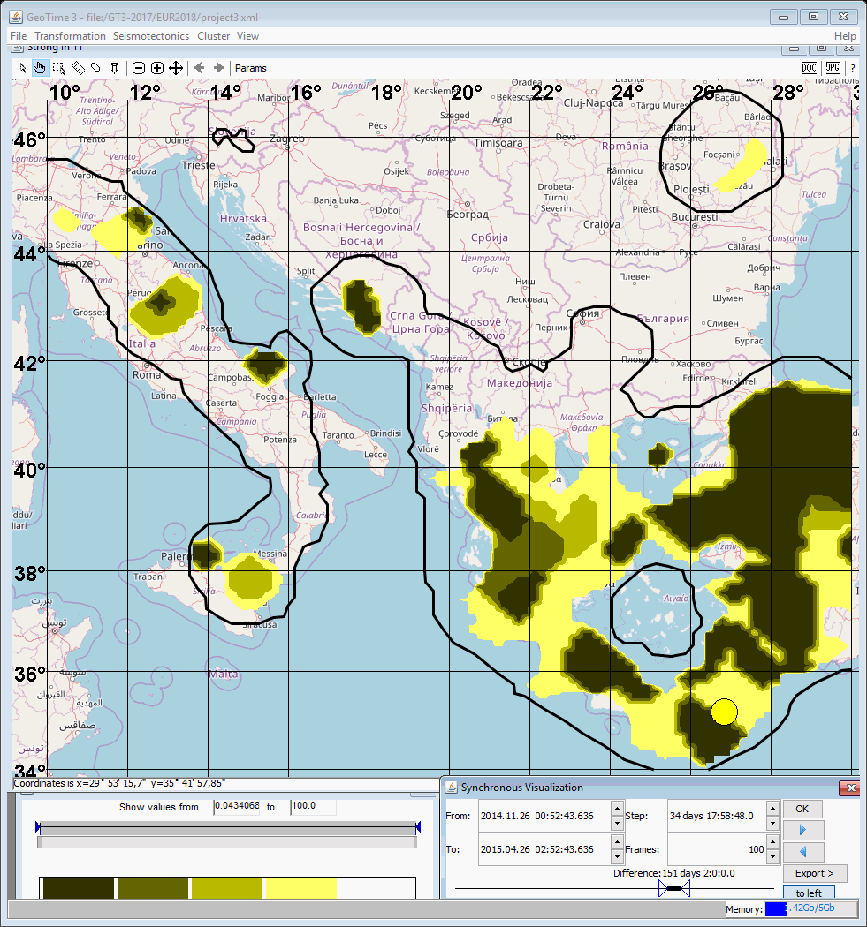

Slide 102
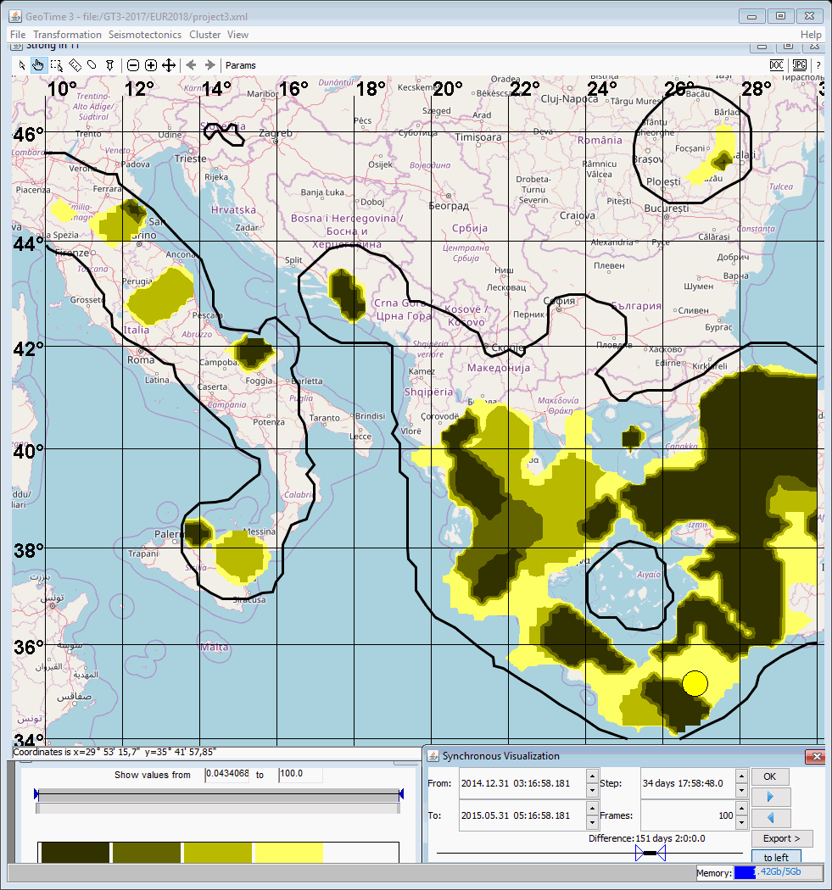

Slide 103


Slide 104
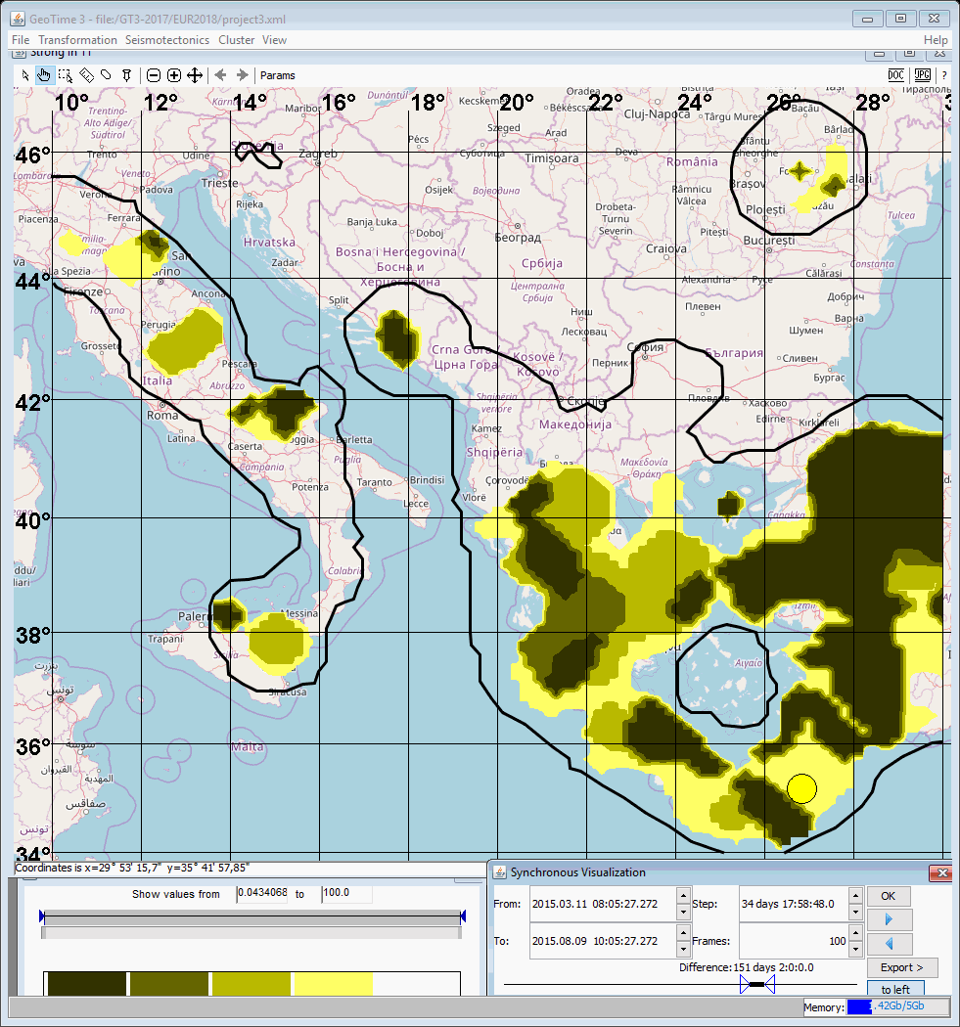

Slide 105
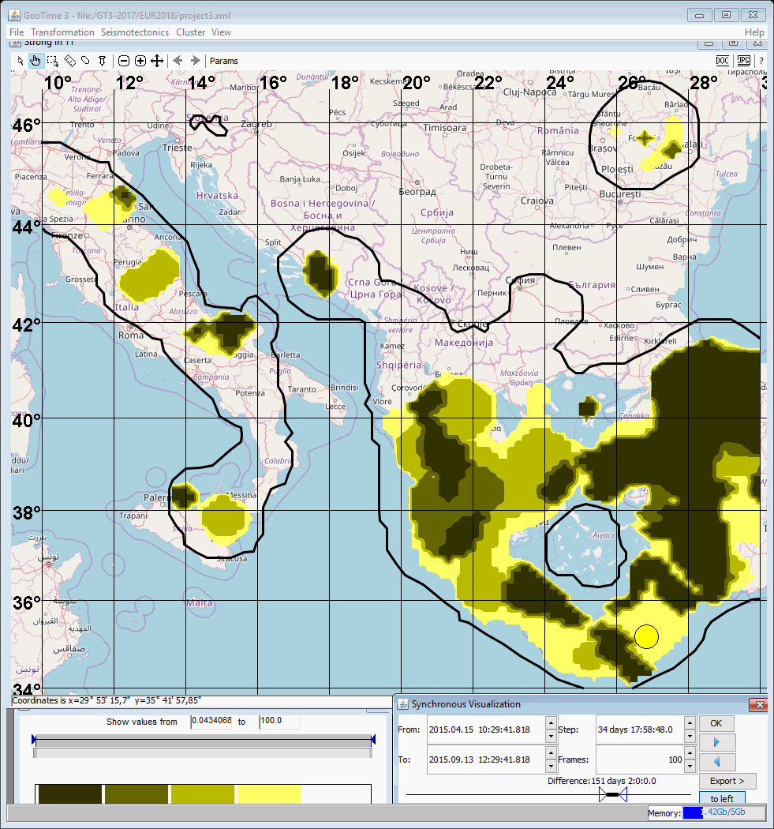

Slide 106
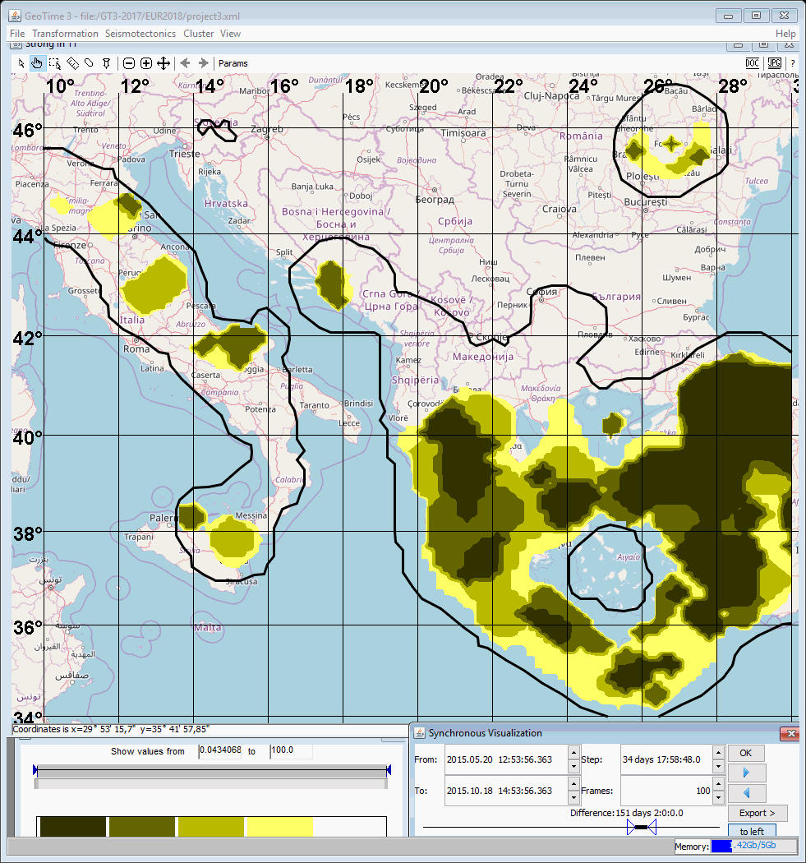

Slide 107
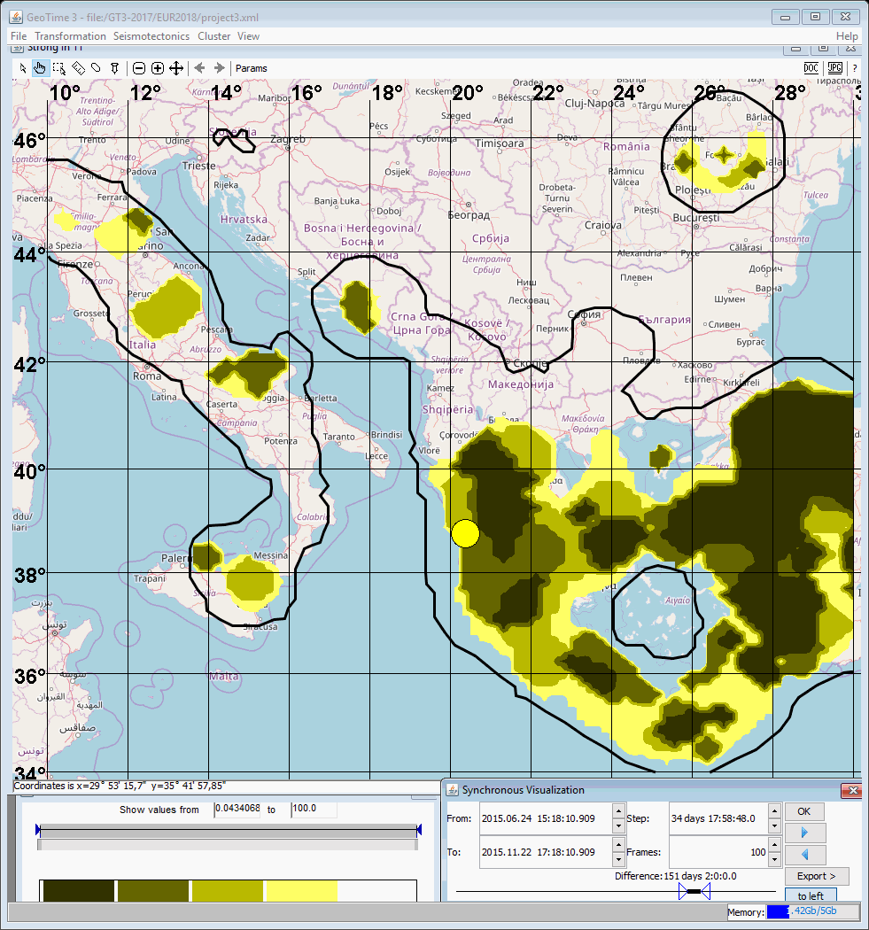

Slide 108
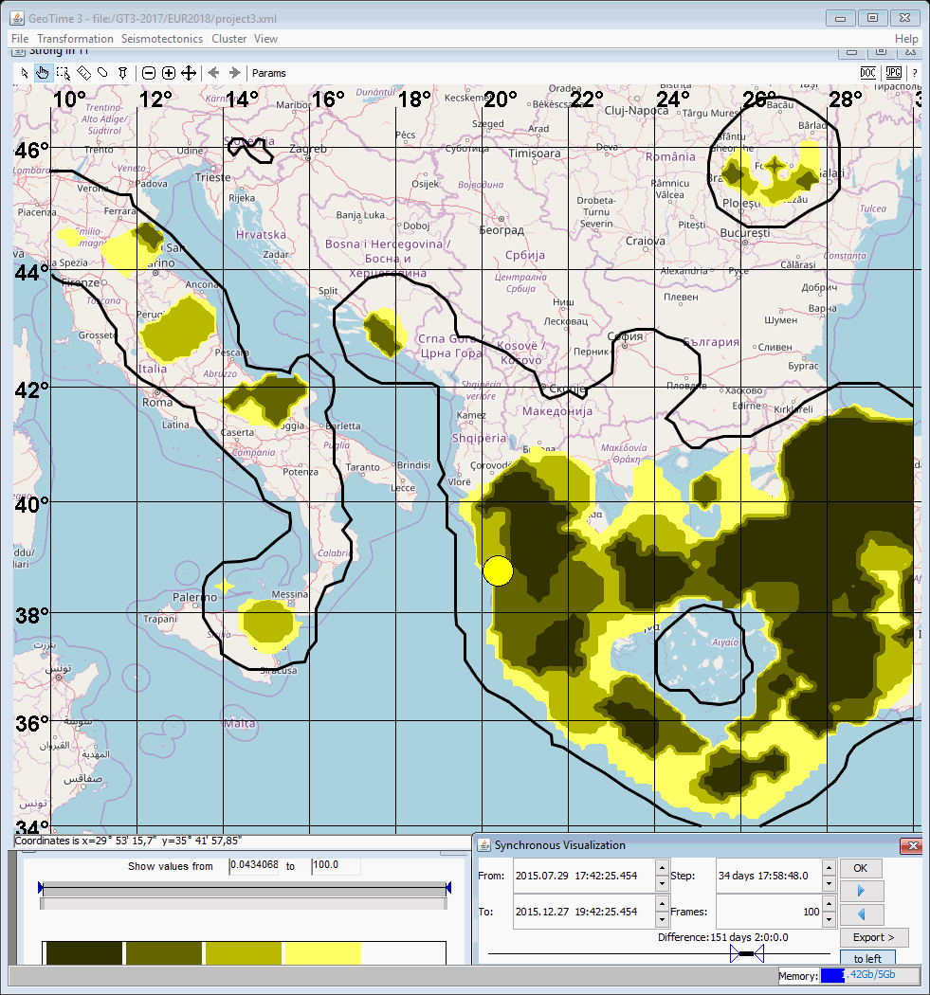

Slide 109


Slide 110


Slide 111


Slide 112


Slide 113


Slide 114


Slide 115


Slide 116


Slide 117


Slide 118


Slide 119


Slide 120


Slide 121


Slide 122


Slide 123


Slide 124


Slide 125


Slide 126


Slide 127


Slide 128


Slide 129


Slide 130


Slide 131
4.3. Japan
Initial data: Earthquakes recorded by the Japan Meteorological Agency (JMA), taken from the ISC catalog.
Data for feature fields:
Time interval 27.05.1983-15.04.2016
(the interval has been reduces because the catalog is not homogeneous after 15.04.2016)
Magnitudes М ≥ 2.5
Depth of hypocenters H≤ 160 км
Data for predictable events:
Magnitudes М ≥ 6.0
Depth of hypoventers H≤ 60 км
Testing interval: 2008-2016, 151 events.
Parameters of the alarm field:
Cylinder of alarm: R = 16 km, T = 100 days.

Slide 132
Grid feature fields (grid step: longitude 0.18°, latitude 0.15°, time Δt = 49 days).
F₁ is 3D fields of positive temporal anomalies of density of earthquakes (density: kernel smoothing with parameters R=50 km, T=100 days; anomalies: Student’s t-statistics with parameters Тbackground=3650 days, Тtest=196 days).
F₂ is 3D field of positive temporal anomalies of mean earthquake magnitude (mean magnitudes: kernel smoothing with parameters R=100 km, T=730 days; anomalies: Student’s t-statistics with parameters Тbackground=3650 days, Тtest=196 days).
F₄ is 2D field of density of earthquake epicenters (kernel smoothing in the interval from 1988 till 2008 with parameter R=50 км).

Slide 133

Forecast probabilities and volumes of alarm
Volume of alarm V | Number of correct forecasts | Forecast probability U | U/V
0.05 | 82 | 0.54 | 10.8
0.1 | 103 | 0.68 | 6.8
0.15 | 112 | 0.74 | 4.9
0.2 | 124 | 0.82 | 4.1
Dependence of the forecast probability U on the volume of alarm V for 151 earthquakes in 2009-2016. with magnitudes M≥6.0 and depths of hypocenters H≤60 km

Slide 134

Predictable earthquake epicenters in 2008-2016.
The intensity of the fill tone decreases with increasing volume of the alarm, at which the epicenter is predicted: 0.05, 0.1, 0,15, 0.2.
White color: the earthquake is predicted with an alarm volume of more than 0.2.

Slide 135
Testing
The frames are taken with the interval of 34 days and 18 hours.
Epicenters of earthquakes are shown in the interval of 151 days.

Slide 136


Slide 137


Slide 138


Slide 139


Slide 140


Slide 141


Slide 142


Slide 143


Slide 144


Slide 145


Slide 146


Slide 147


Slide 148


Slide 149


Slide 150


Slide 151


Slide 152


Slide 153


Slide 154


Slide 155


Slide 156


Slide 157


Slide 158


Slide 159


Slide 160


Slide 161


Slide 162


Slide 163


Slide 164


Slide 165


Slide 166


Slide 167


Slide 168


Slide 169


Slide 170


Slide 171


Slide 172


Slide 173


Slide 174


Slide 175


Slide 176


Slide 177


Slide 178


Slide 179


Slide 180


Slide 181


Slide 182


Slide 183


Slide 184


Slide 185


Slide 186


Slide 187


Slide 188


Slide 189


Slide 190


Slide 191


Slide 192


Slide 193


Slide 194


Slide 195


Slide 196


Slide 197


Slide 198


Slide 199


Slide 200


Slide 201


Slide 202


Slide 203


Slide 204


Slide 205


Slide 206


Slide 207


Slide 208


Slide 209


Slide 210


Slide 211


Slide 212


Slide 213


Slide 214


Slide 215


Slide 216


Slide 217


Slide 218


Slide 219


Slide 220


Slide 221


Slide 222


Slide 223


Slide 224


Slide 225


Slide 226


Slide 227


Slide 228


Slide 229


Slide 230


Slide 231


Slide 232


Slide 233


Slide 234


Slide 235
4.4. California
Initial data: Earthquake from the catalogue of National Earthquake Information Center (NEIC).
Data for feature fields:
Time interval 01.01.1983-15.02.2018
Magnitudes М ≥ 2.0
Data for predictable events:
Magnitudes М ≥ 5.7
Testing interval: 2009-2018, 9 events.
Parameters of the alarm field:
Cylinder of alarm: R = 14 km, T = 100 days.
For each event q, 2 precursors were chosen. This means that, for each precursor cylinder of event q the program selected 2 vectors f^{(q)} with minimum alarm volumes v^{(q)}.

Slide 236
Grid feature fields (grid step: longitude 0.125°, latitude 0.11°, time Δt = 49 days).
F₁ is 3D fields of positive temporal anomalies of density of earthquakes (density: kernel smoothing with parameters R=50 km, T=100 days; anomalies: Student’s t-statistics with parameters Тbackground=3650 days, Тtest=196 days).
F₂ is 3D field of positive temporal anomalies of mean earthquake magnitude (mean magnitudes: kernel smoothing with parameters R=100 km, T=730 days; anomalies: Student’s t-statistics with parameters Тbackground=3650 days, Тtest=196 days).
F₄ is 2D field of density of earthquake epicenters (kernel smoothing in the interval from 1988 till 2008 with parameter R=50 км).

Slide 237
Forecast probabilities and volumes of alarm
Volume of alarm V | Number of correct forecasts | Forecast probability U | U/V
0.05 | 4 | 0.44 | 10.8
0.1 | 4 | 0.44 | 6.8
0.15 | 4 | 0.44 | 4.9
0.2 | 8 | 0.88 | 4.1
Dependence of the forecast probability U on the volume of alarm V for 9 earthquakes in 2009-2018. with magnitudes M≥5.7.

Slide 238

Predictable earthquake epicenters in 2008-2018.
The intensity of the fill tone decreases with increasing volume of the alarm, at which the epicenter is predicted: 0.05, 0.1, 0,15, 0.2.
White color: the earthquake is predicted with an alarm volume of more than 0.2.

Slide 239
Testing
The frames are taken with the interval of 35 days and 6 hours.
Epicenters of earthquakes are shown in the interval of 100 days.

Slide 240


Slide 241


Slide 242


Slide 243


Slide 244


Slide 245


Slide 246


Slide 247


Slide 248


Slide 249


Slide 250


Slide 251


Slide 252


Slide 253


Slide 254


Slide 255


Slide 256


Slide 257


Slide 258


Slide 259


Slide 260


Slide 261


Slide 262


Slide 263


Slide 264


Slide 265


Slide 266


Slide 267


Slide 268


Slide 269


Slide 270


Slide 271


Slide 272


Slide 273


Slide 274


Slide 275


Slide 276


Slide 277


Slide 278


Slide 279


Slide 280


Slide 281


Slide 282


Slide 283


Slide 284


Slide 285


Slide 286


Slide 287


Slide 288


Slide 289


Slide 290


Slide 291


Slide 292


Slide 293


Slide 294


Slide 295


Slide 296


Slide 297


Slide 298


Slide 299


Slide 300


Slide 301


Slide 302


Slide 303


Slide 304


Slide 305


Slide 306


Slide 307


Slide 308


Slide 309


Slide 310


Slide 311


Slide 312


Slide 313


Slide 314


Slide 315


Slide 316


Slide 317


Slide 318


Slide 319


Slide 320


Slide 321


Slide 322


Slide 323


Slide 324


Slide 325


Slide 326


Slide 327


Slide 328


Slide 329


Slide 330


Slide 331


Slide 332


Slide 333


Slide 334


Slide 335


Slide 336


Slide 337


Slide 338


Slide 339


Slide 340
4. Conclusion
Principal elements of the approach
Seismotectonic processes are represented by spatial and spatio-temporal grid fields.
It is assumed that strong earthquakes are preceded by anomalies in the field of extreme values of fields-signs.
If the vector f^{(q)} is the precursor of the event q, then any vector f ≥ f^{(q)} (componentwise) can also precede similar events (monotonicity condition).

Slide 341
Results
The IT part of the project has been completed.
Testing showed that the method of minimum volume of alarm is quite effective for automatic forecasting of earthquakes.

Slide 342
Continuation of research and new problems
The prediction problem M≥M* is not quite physically justified: the anomalies before the M* event do not fundamentally differ from the anomalies before the event M*-δM. Perhaps it is necessary to solve the problem for several threshold magnitudes M≥M1*, M≥M2* M≥M3* ...?
Is there enough information about the process of earthquake preparation in order to forecast the place, time and magnitude of the earthquake (regression problem).
What new seismological characteristics should be added to the forecast system?
What new data should be added to the forecast system? GPS??

Slide 343
Спасибо за внимание !

